Slide 1
Airway Trauma
Justin Blaskowsky

Slide 2
airway trauma - Learning objectives
Airway
Describe Essential Airway Anatomy
Explain Common Interventions
Describe 2 Case Studies of Common Airway Trauma
Explain Critical Thinking in Airway Management
Describe Current Practices with Difficult Airways
Discuss Overall Management of Prehospital Airways
Notes:
Be prepared for some fun pictures

Slide 3
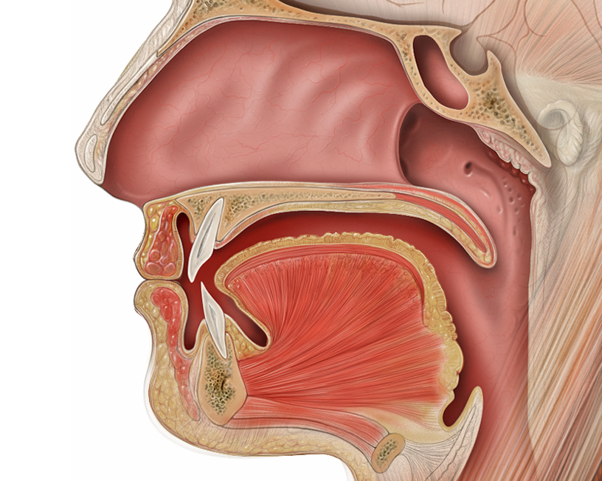
Mouth and nose - oro/nasopharyngeal airway
airway
Type to enter a caption.

Slide 4
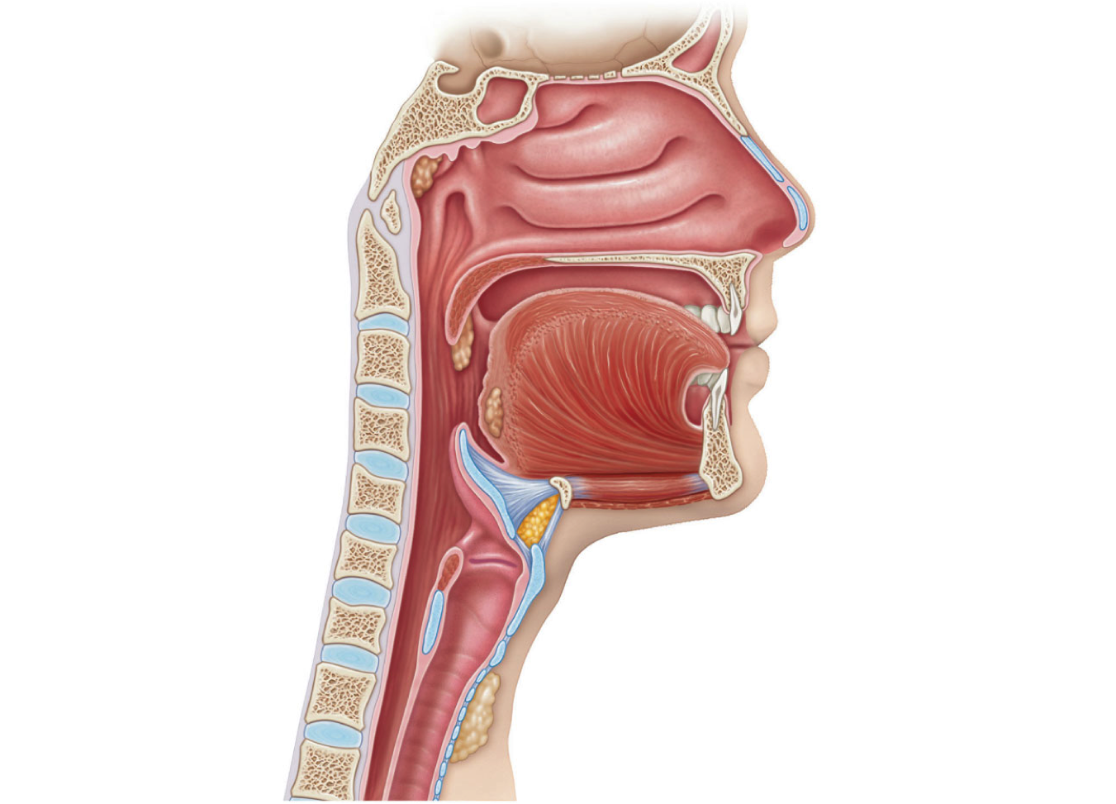
Neck - trachea & laryngopharynx
airway
Type to enter a caption.

Slide 5
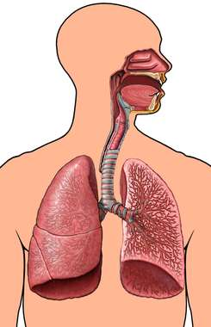
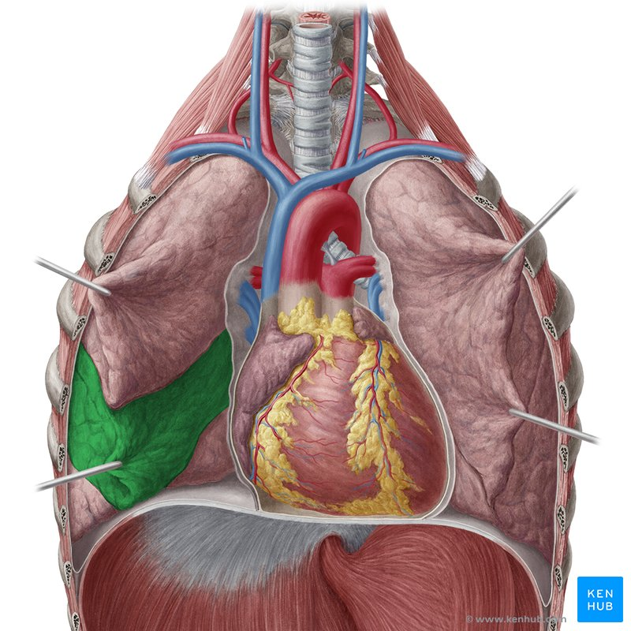
chest - Thoracic Airway
airway
Type to enter a caption.
Type to enter a caption.

Slide 6
Interventions
Airway
NC/NRB
BVM
NPA/OPA
Advanced Airway (bypassing oropharynx) - King/iGel/LMA/ET-Tube
Surgical Interventions - Cric/chest tube/decompression

Slide 7
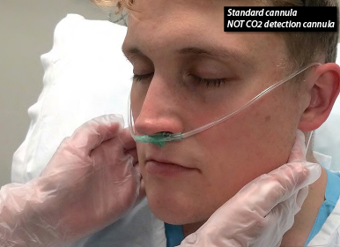
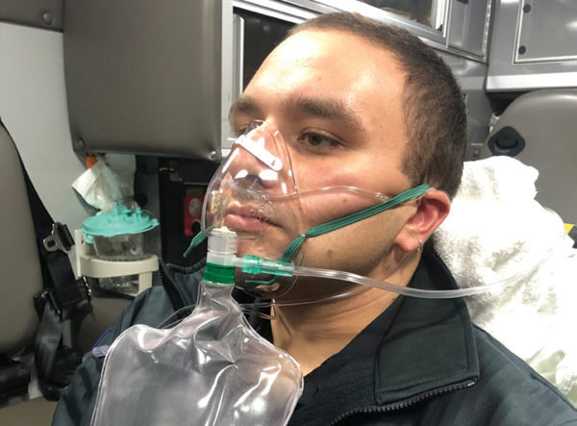
Nasal Cannula / Non-rebreather
Airway
Indications: Minor Trauma, no immediate airway compromise, low SaO2, Pre-intubation, & non trauma patients
Contraindications: Nasal trauma, nasal occlusion (epistaxis)
Indications: minor/major trauma, low SaO2, no immediate airway compromise, pre-intubation
Contraindication: maxillofacial trauma, general airway occlusion

Slide 8
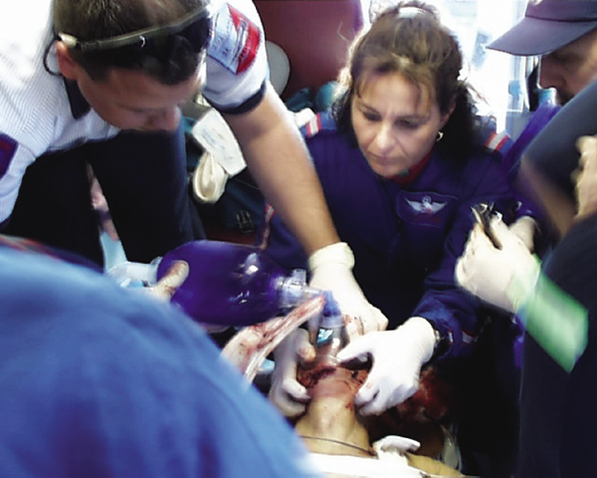
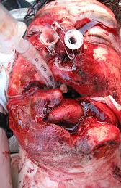
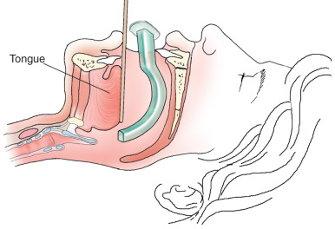
BVM/NPA/OPA
Airway
Indications: obesity, difficult bagging, nasal trauma, apnea
Contraindications: Oral trauma, gag reflex, obstructed lower airway
Indications: Used in conjunction with NPA/OPA/ET-tubes, low SaO2, non-obstructive airway compromise
Contraindications: obstructed airway, tracheal perforation, c-spine trauma (relative),
Indications: Obviously trauma, obesity, mouth trauma, apnea
Contraindications: Consciousness, (head trauma?), obstructed lower airway

Slide 9
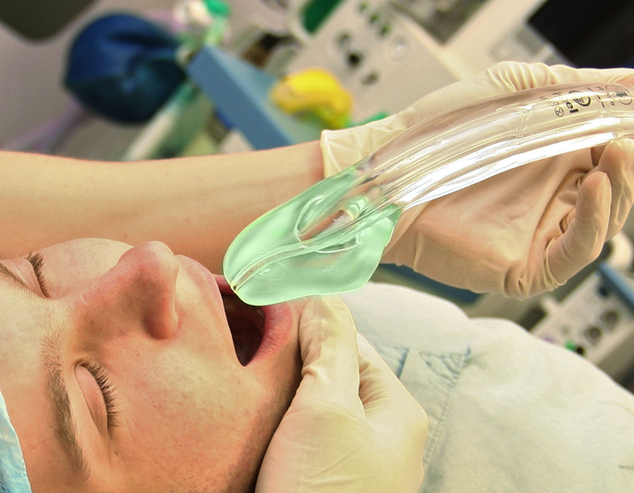
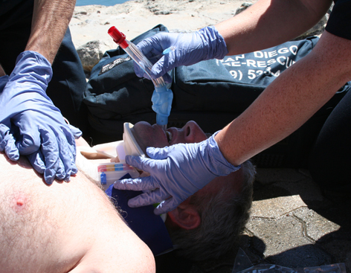
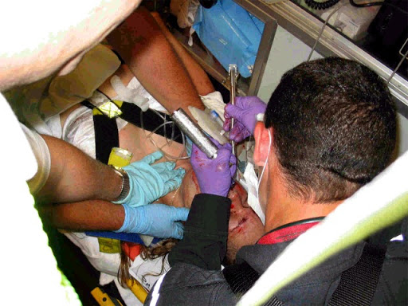
Igel/king/Et-tube
Airway
Indications: need for advanced airway, failed intubation
Contraindications: oral trauma, obstruction, emesis, awake people, gag reflex
Indications: need for advanced airway, failed intubation
Contraindications: oral trauma, obstruction, emesis, awake people, gag reflex
Indications: need for advanced airway, airway protection
Contraindications: massive facial trauma, tracheal perforation, gag reflex

Slide 10
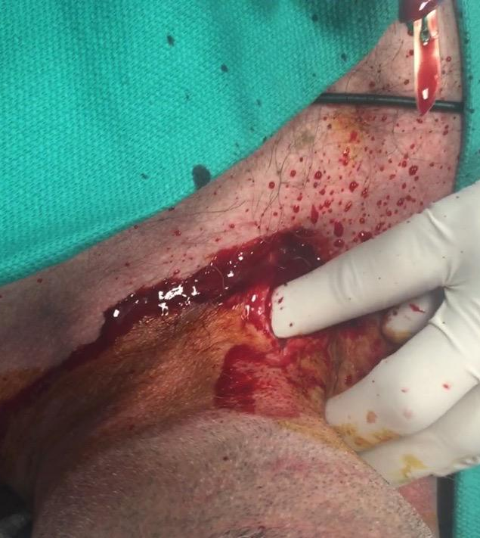
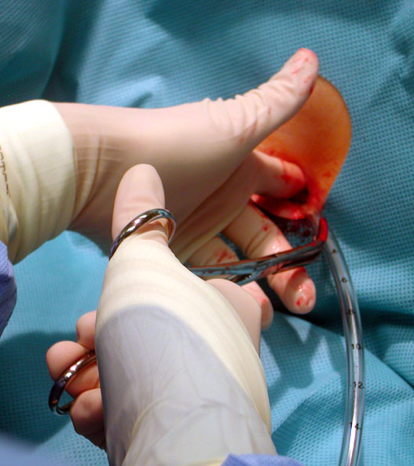
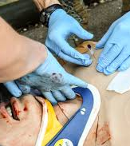
Surgical Fun
Airway
Indications: Airway trauma, immediate need for airway, tongue/throat swelling, unable to bag/intubate/place advanced airway
Contraindications: throat trauma, transected trachea
Indications: Hemo/pneumothorax
Contraindications: <15% pneumo
Indications: Hemo/pneumothorax, Placement?
Contraindications: <15% pneumo
Notes:
ATLS guidelines have now specified that a chest decompression should be done in the 5th intercostal space anterolateral or midaxillary. Why?
used to be 2nd intercostal space midclavicular

Slide 11
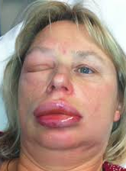
Type to enter a caption.

Slide 12
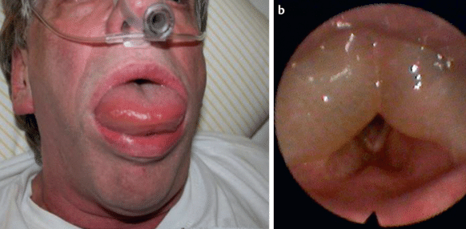
Type to enter a caption.
Notes:
Ace Inhibitor Angioedema

Slide 13
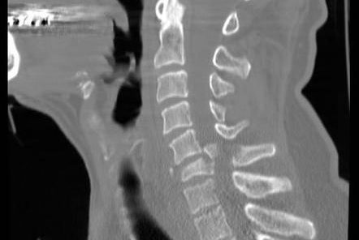
Type to enter a caption.

Slide 14
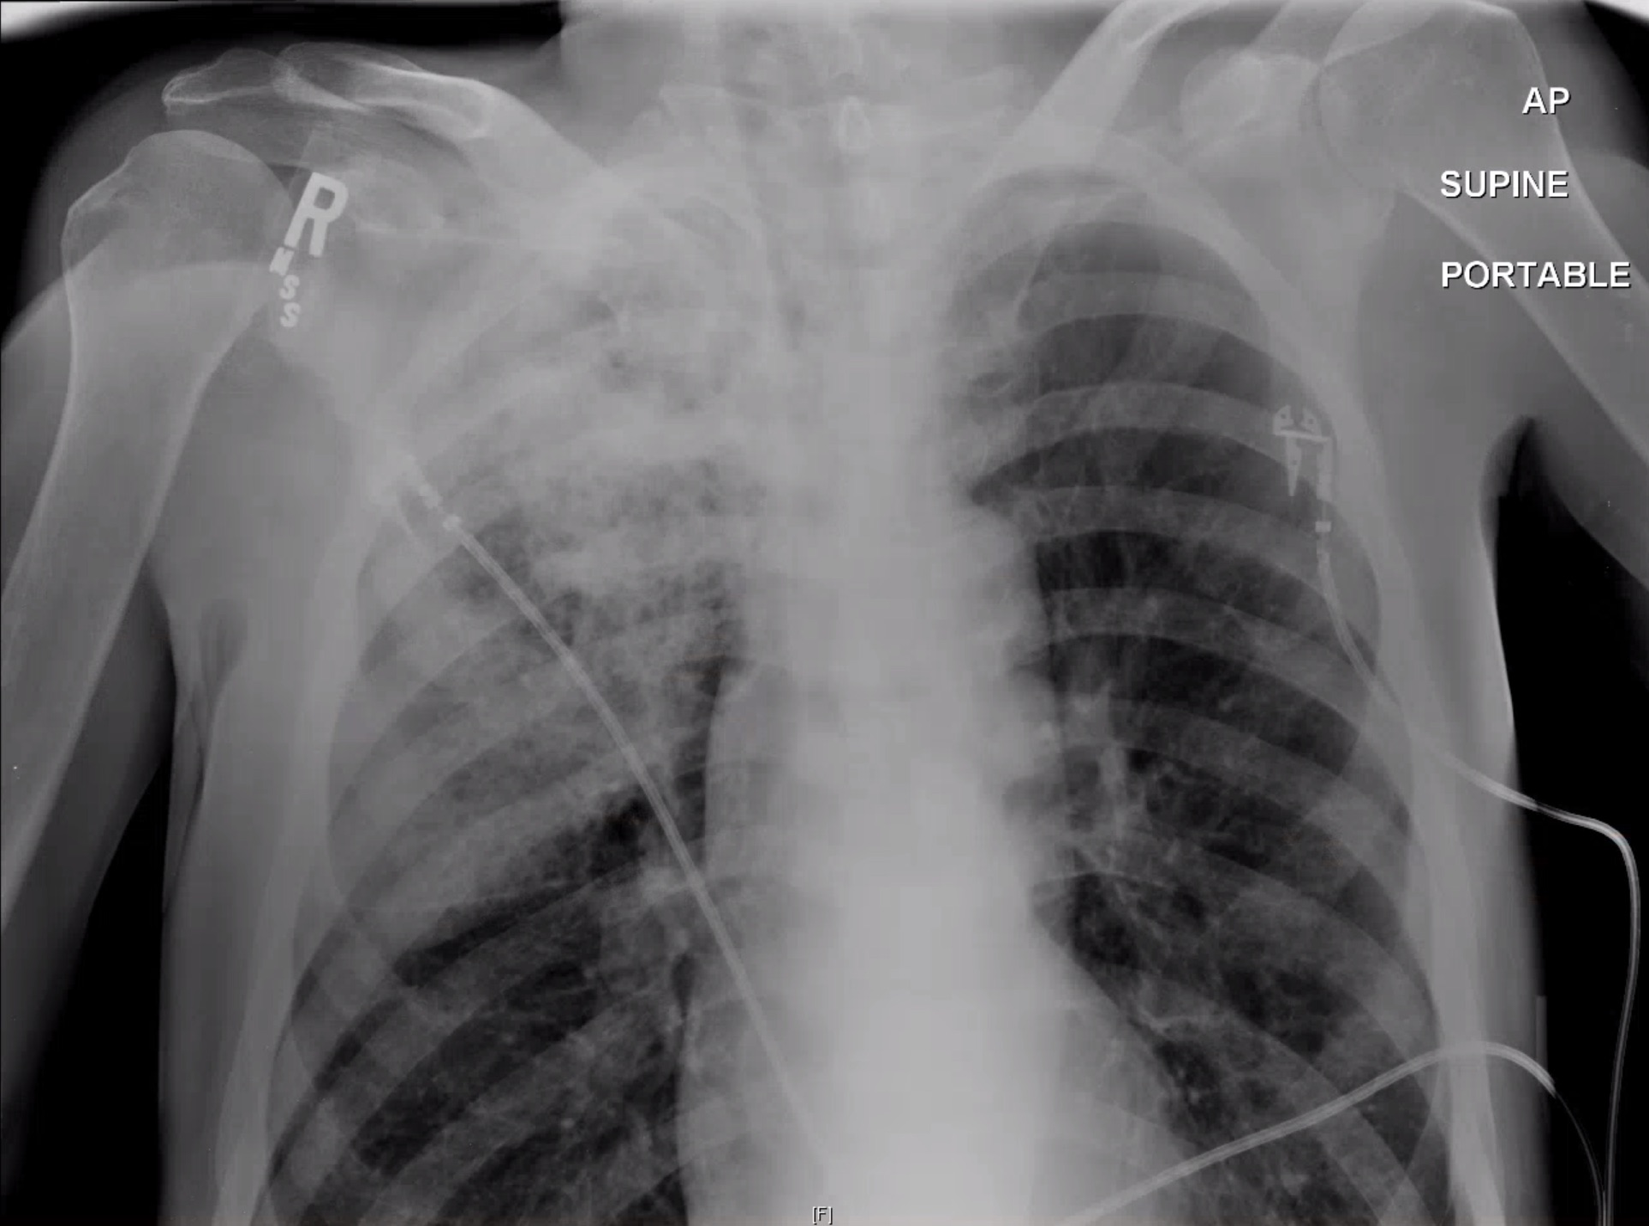
Type to enter a caption.
Notes:
Tracheal Perforation

Slide 15
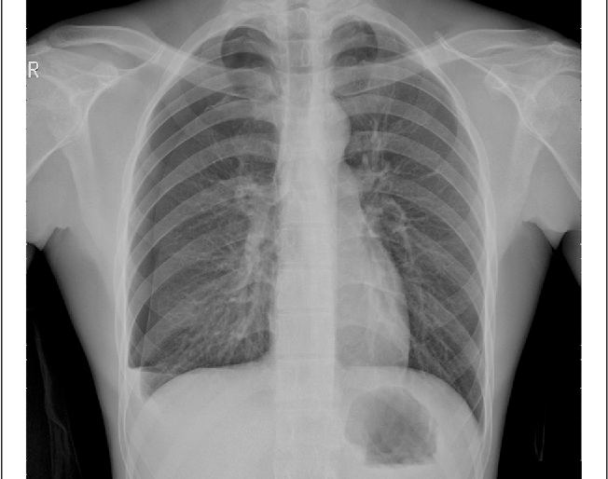
Type to enter a caption.
Notes:
Fluid

Slide 16
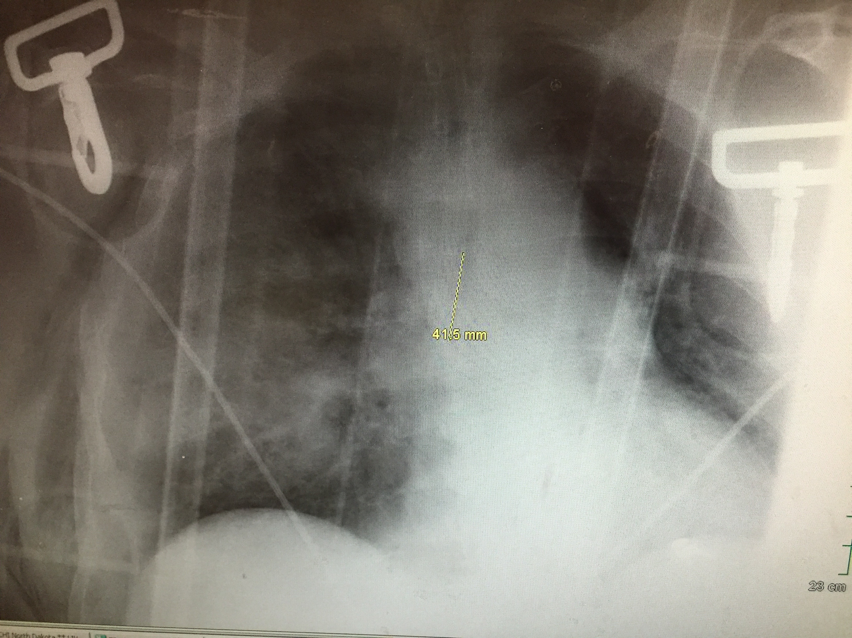
Type to enter a caption.
Notes:
Right scapula broken ribs and fluid

Slide 17
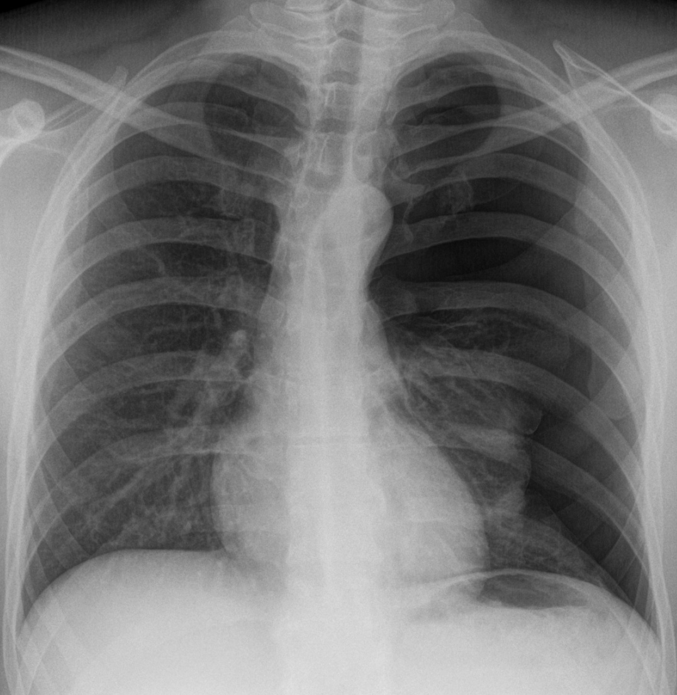
Type to enter a caption.
Notes:
Pneumo

Slide 18
Airway Pitfalls
Marcus Pearson
Notes:
Pitfall: defined as a hidden or unsuspected danger or difficulty.

Slide 19

A path we all follow
The unknown

Slide 20
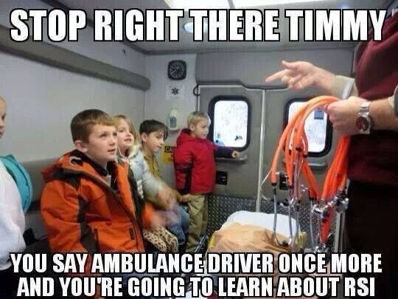
What this is not
Airway 101
Type to enter a caption.
Notes:
How to use your tools
Your protocols
History Lessons
Me being the one all end all.

Slide 21

What this talk really is about
Airway 102
Type to enter a caption.
Notes:
Management vs Performance
Critical Thinking
Best practices
Why some things are better than others
What should be next
How this all works in the back of a dank ambulance
Some really nasty pictures

Slide 22
What makes you think you know everything?
Airway 103
Notes:
I don’t and never will
My practices
My issues
My favorite quotes
Medical director

Slide 23
weiser’s Law of airway management
Airway 104
Anything that can go wrong will go wrong. Usually at the same time.
The most important piece of equipment will either be lost or break in the middle of the procedure.
If you are confident about an airway, don’t worry that will pass quickly.
The severity of hypoxemia is proportional to the Mallampati class multiplied by the gastric residual volume.

Slide 24
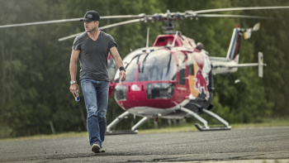
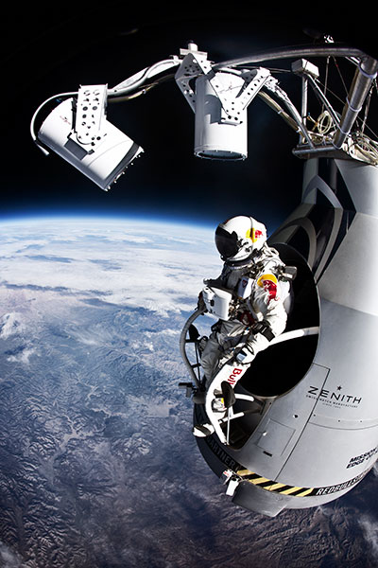
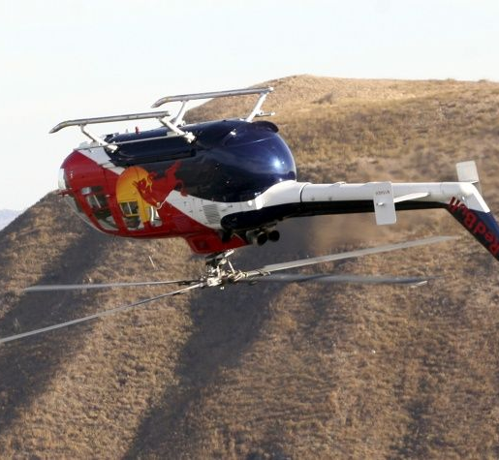
Airway 105
Type to enter a caption.
Type to enter a caption.
Type to enter a caption.
Notes:
Who flys the bird?
Who is this guy?
Now everyone will know who it is.
Mindset
Training
Preparation
Practice or more training
Actually doing the damn thing

Slide 25
Now we move to strike
Airway 106
Moving from Procedures to management of a team
How to set up your team
Mindset of team members
Notes:
General thinking and how to approach it
be methodical and teach it to a 3 year old

Slide 26
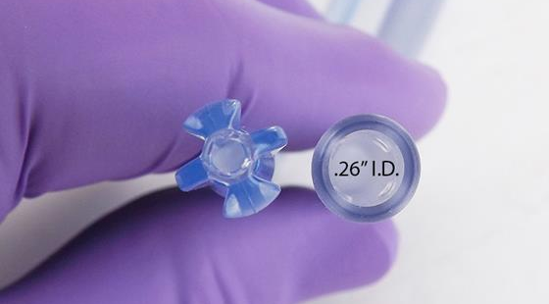
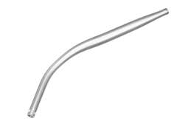
Equipment musts
Airway 107
Suction (large bore)
Tubes/laryngoscopes/O2
More suction
Bougie
Probably more suction
Backups
Type to enter a caption.
Type to enter a caption.
Notes:
Dr. Ducanto
Why are these things important?
What else can we utilize in an environment of crap
First thing after an ET tube is to put in a freaking NG/OG tube

Slide 27
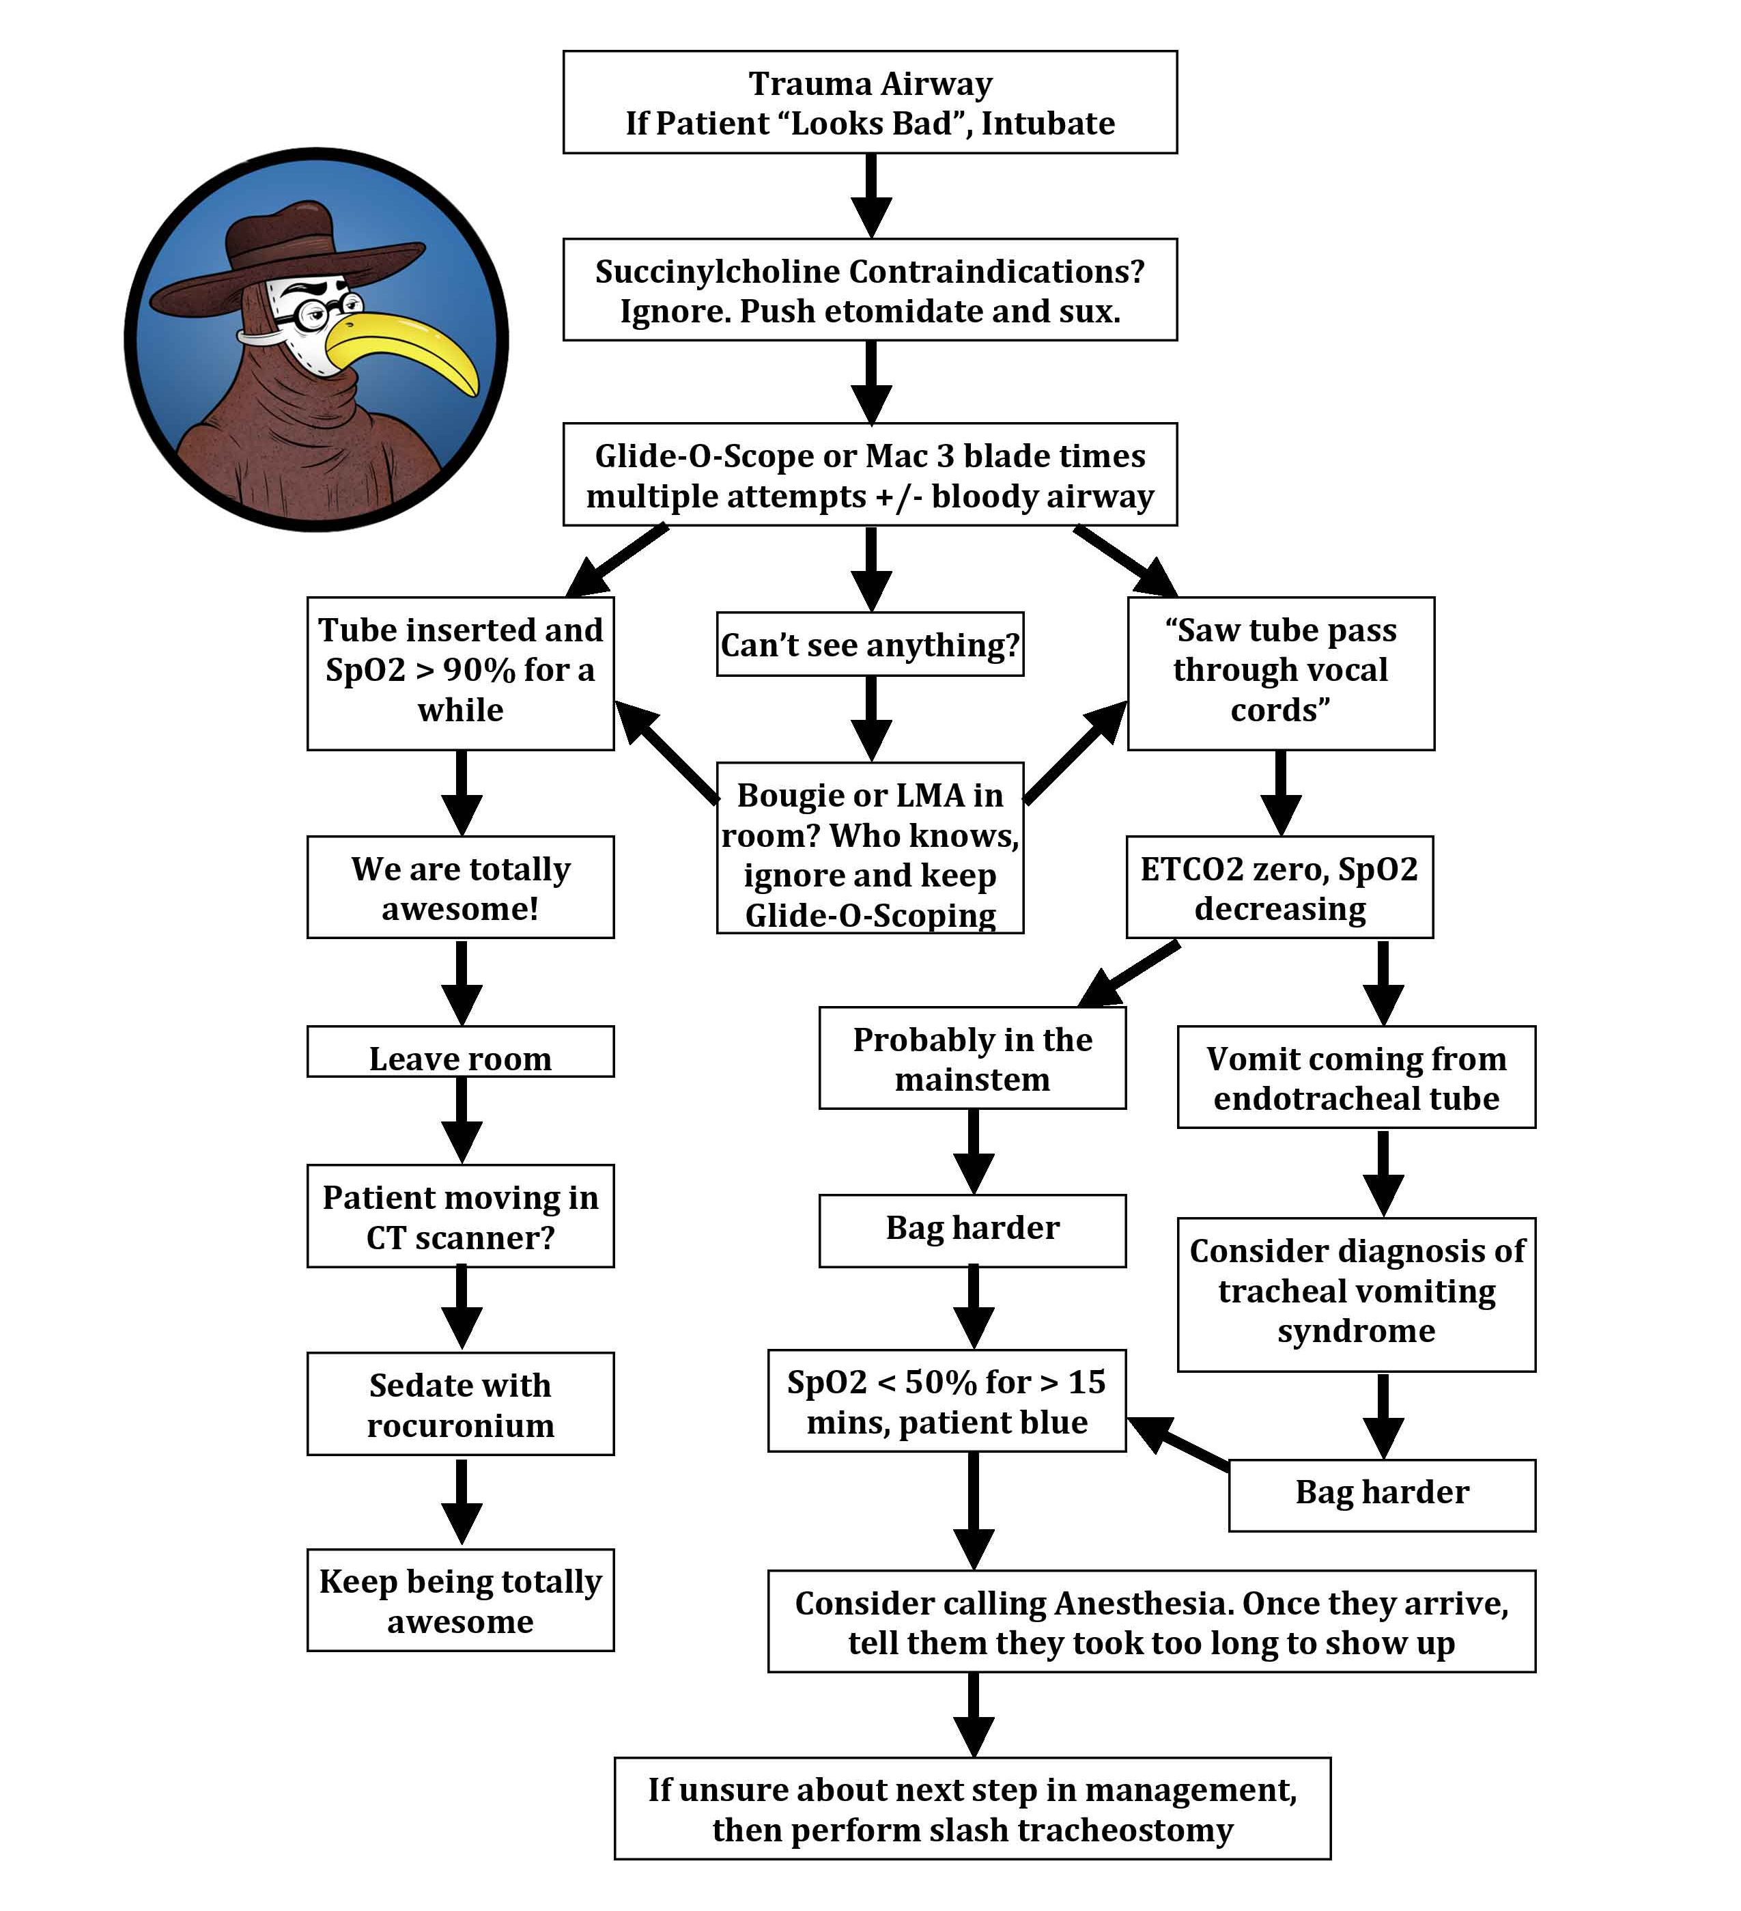
Humor me
airway 109
Type to enter a caption.

Slide 28
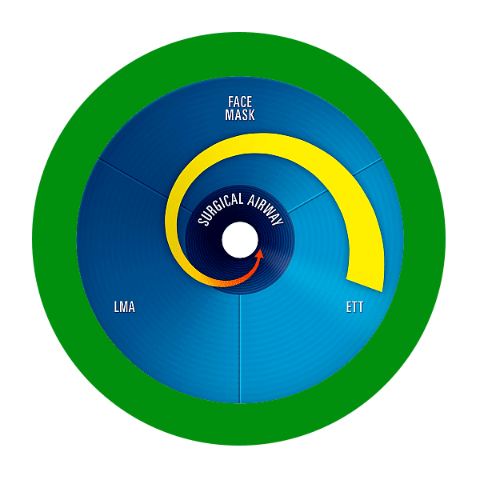
entering insanity
airway 110
Type to enter a caption.
Notes:
Dr. scott weingart
First cric and how long it took compared to the second one.
What made me even think this way?
How much did I practice this algorithm?

Slide 29
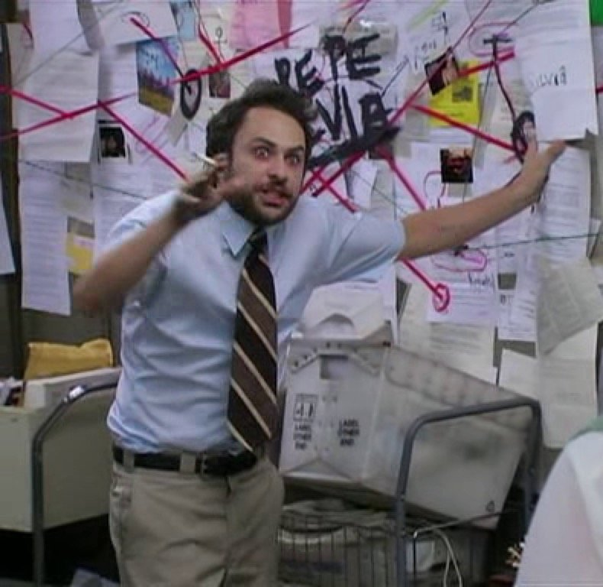
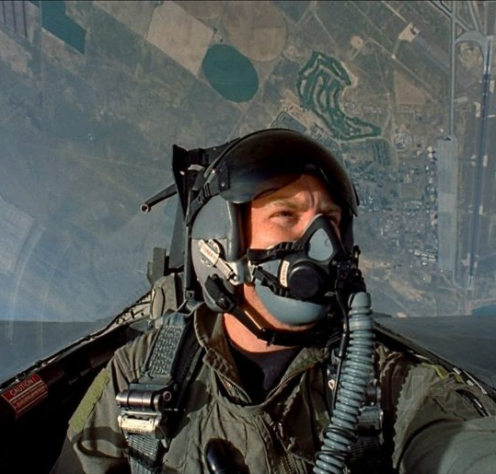
thinking is hard
airway 111
Type to enter a caption.
Type to enter a caption.
Notes:
Simplify your life!!!
Management
OODA Loops
Practice will help
10,000 hour rule
Do checklists help?

Slide 30
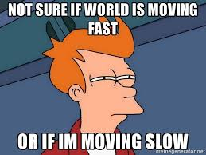
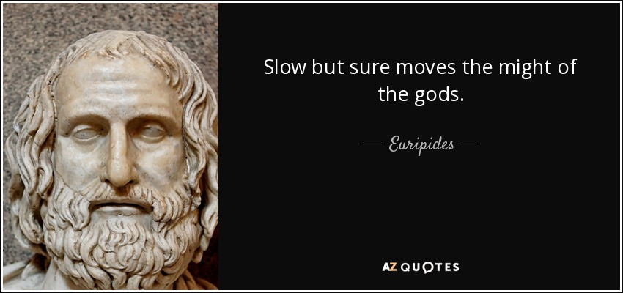
2 types of airways
Airway 112
Need a tube yesterday
Type to enter a caption.
Need a tube today
Type to enter a caption.
Notes:
tell me the difference on the whiteboard

Slide 31
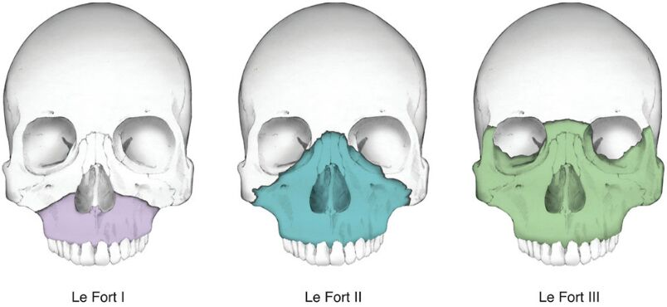
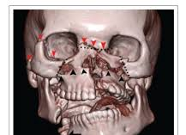
Type to enter a caption.
Type to enter a caption.

Slide 32
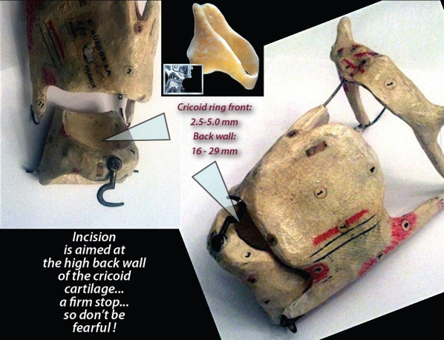
what about cric’s?
Airway 113
Type to enter a caption.
Notes:
great talk by Dr. Levitan… He is a great airway educator on difficult airways.
Situational backup
Situational Crics
Lets manage these together
What type of cric really? and does it matter?

Slide 33
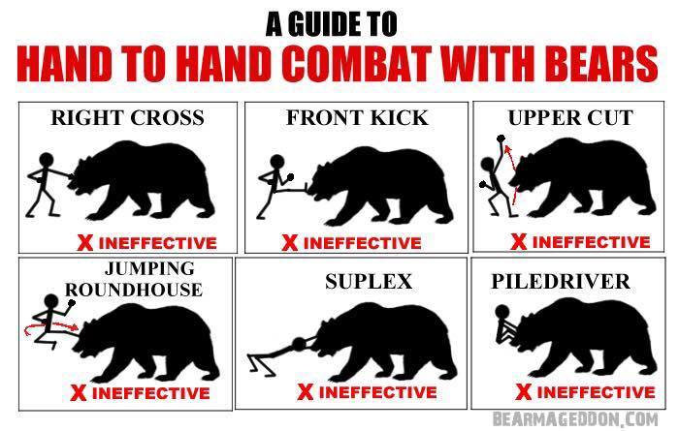
The perfect airway
Airway 114
Type to enter a caption.
Notes:
Whiteboard this. Walk through the process.
Give a patient case (25 yo female polypharm OD). no other factors. Breathing but barely, minor secretions,
in the ambulance, 30 min transport
Is there such a creature?
What would this look like? what equipment do I need? Where is my checklist?
How do I plan for this?
Talk about the myths of different tools

Slide 34
The Procedure itself - the checklist
Airway 115
Preparation
Pre-oxygenation
Pretreatment
Paralysis with induction
Protection
Placement
Post intubation management
Notes:
who should be doing what.
How to make this massive protocol into a checklist that’s easy to use

Slide 35
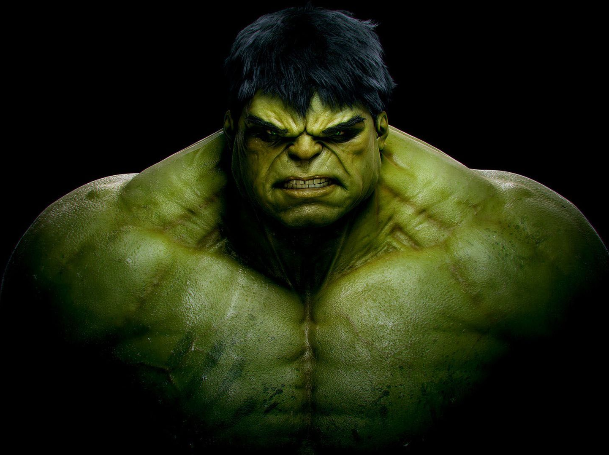
Drugs and more drugs
Airway 1,000
Etomidate
Ketamine
Succinylcholine
Rocuronium
Vecuronium
Fentanyl
Versed
Type to enter a caption.
Notes:
walk through this as a group

Slide 36
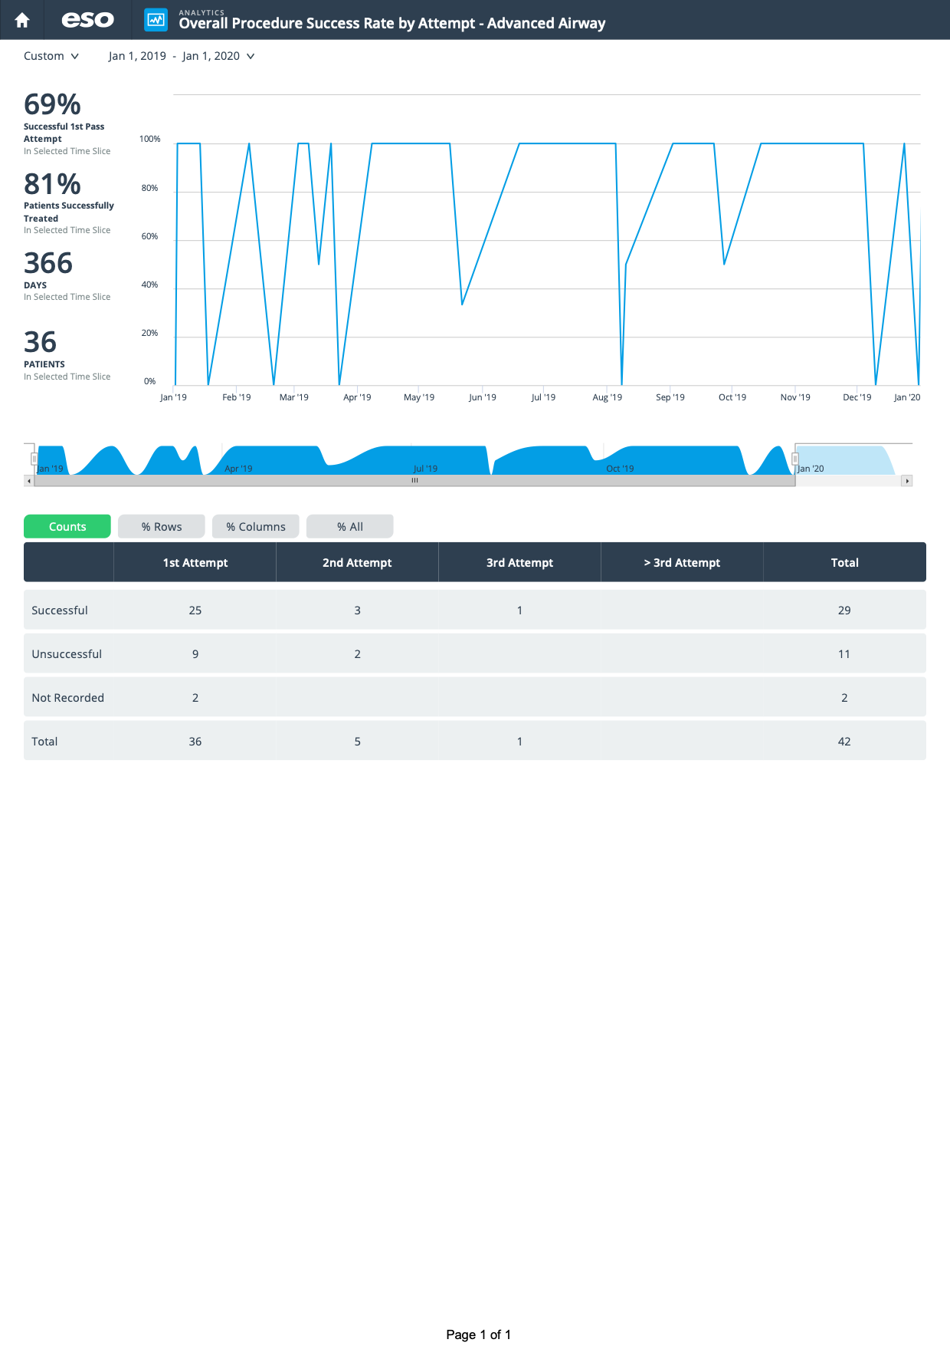
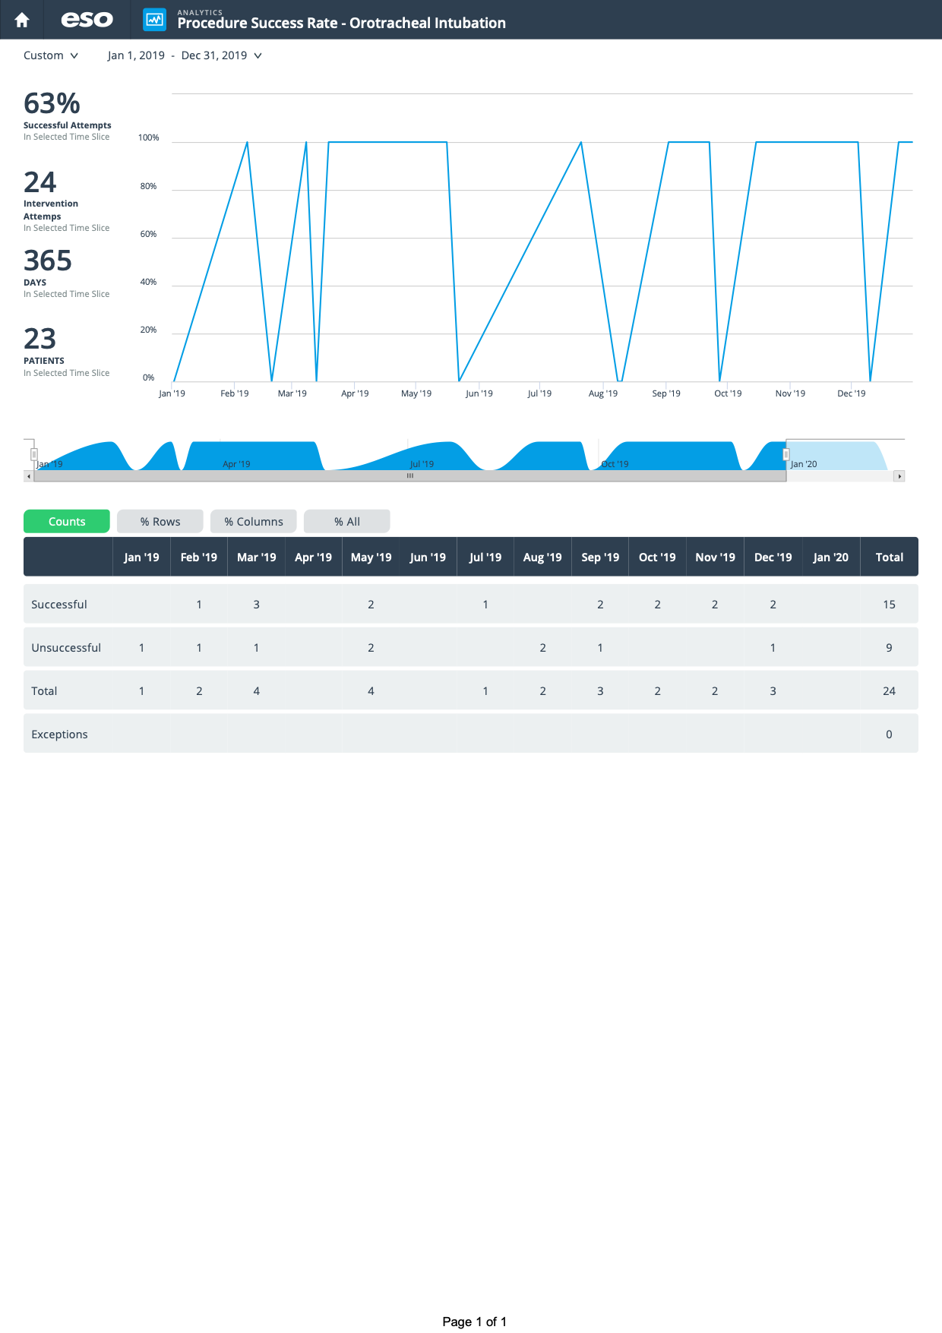
What about your department?
airway 2,000
How many a year?
What is the success/fail rate?
Type to enter a caption.
Type to enter a caption.
Notes:
For this I am simply showing the data for the past year.

Slide 37
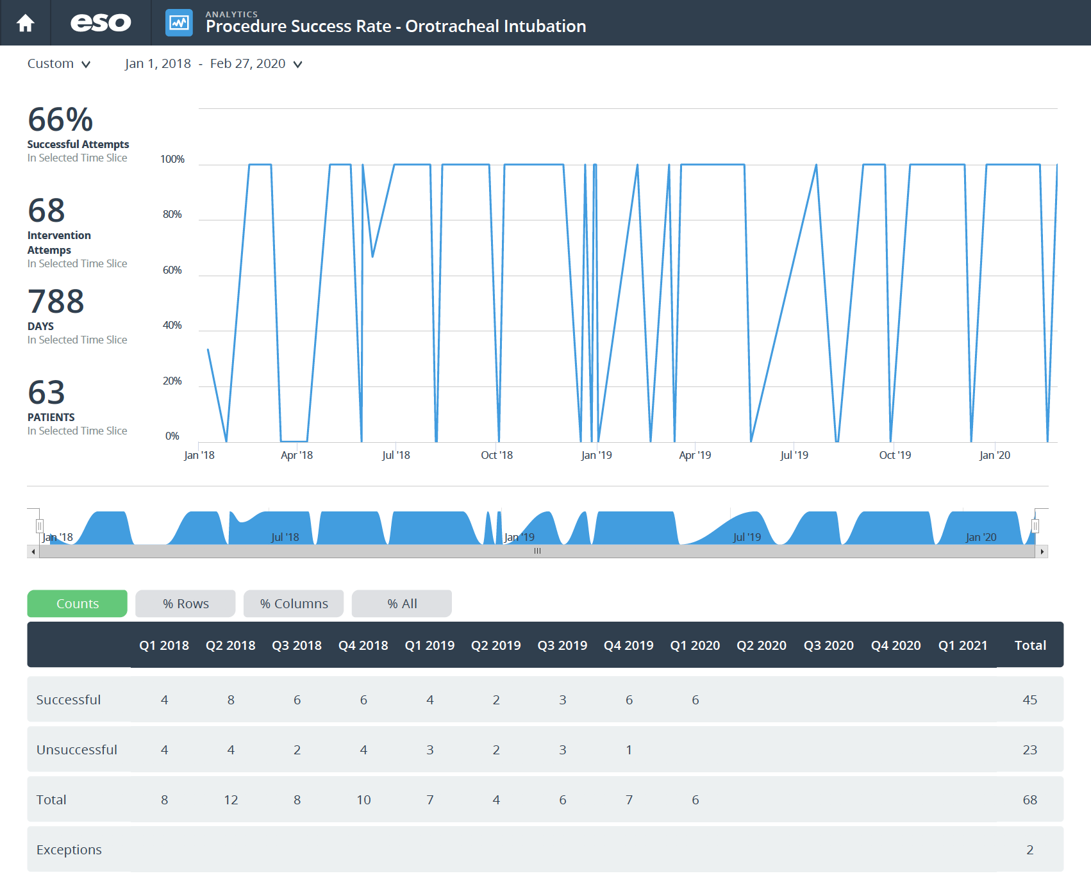
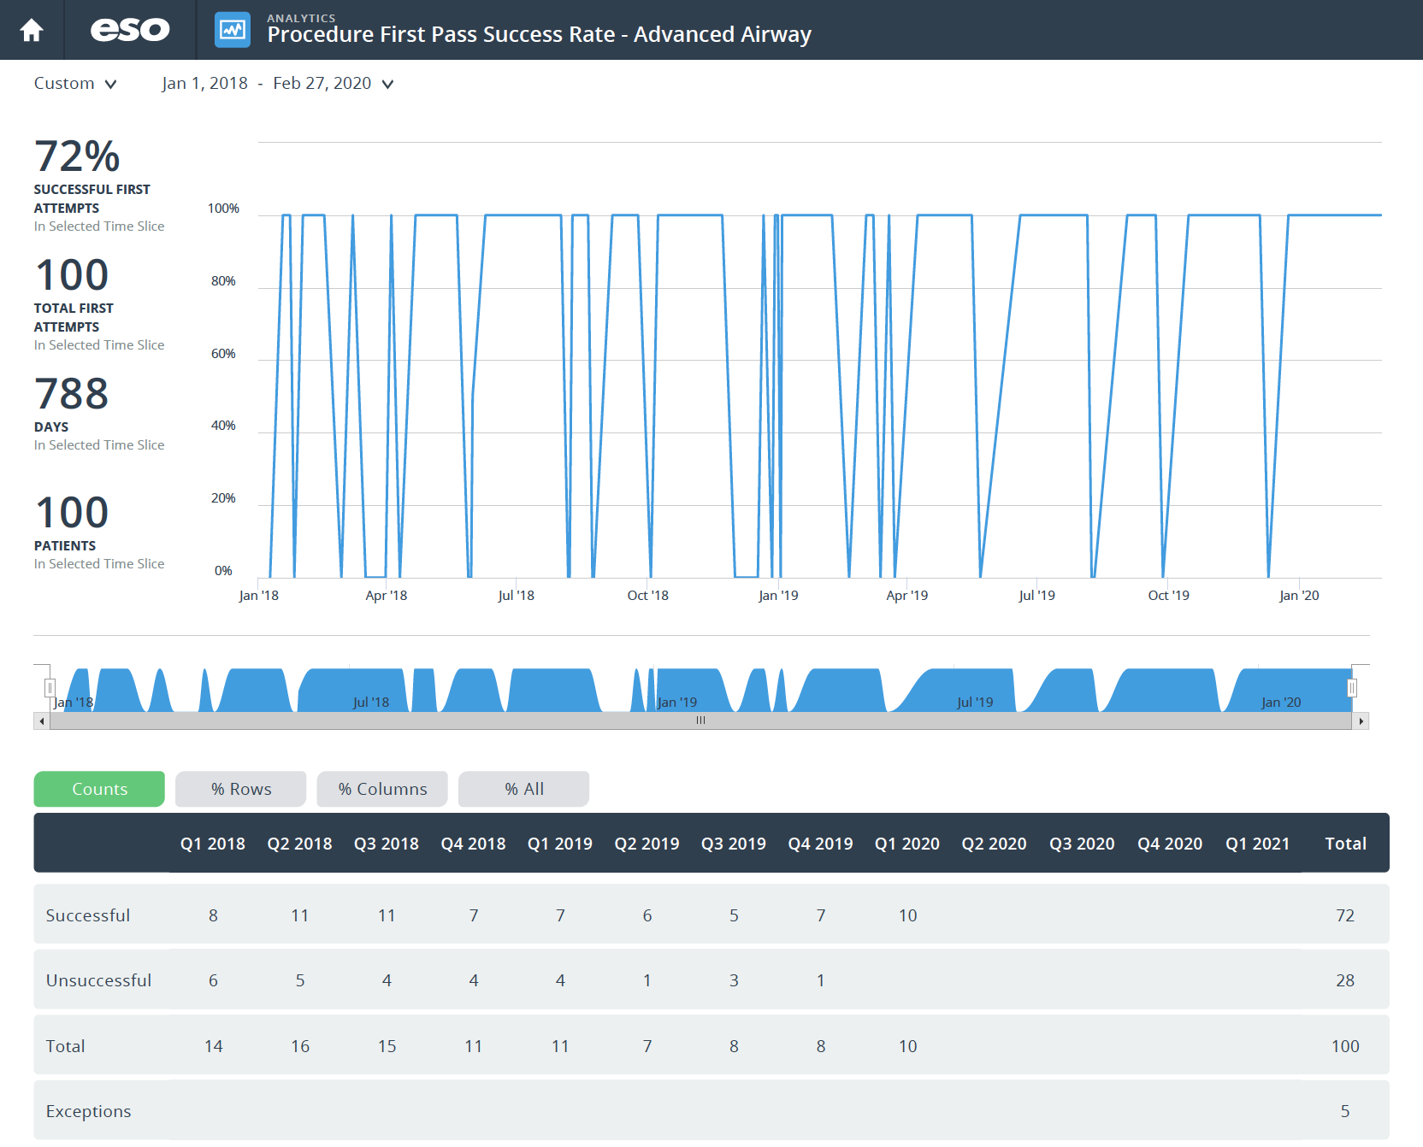
What about your department?
airway 2,000
How many since ESO started?
What is the success/fail rate?
Type to enter a caption.
Type to enter a caption.
Notes:
Since january 2018

Slide 38
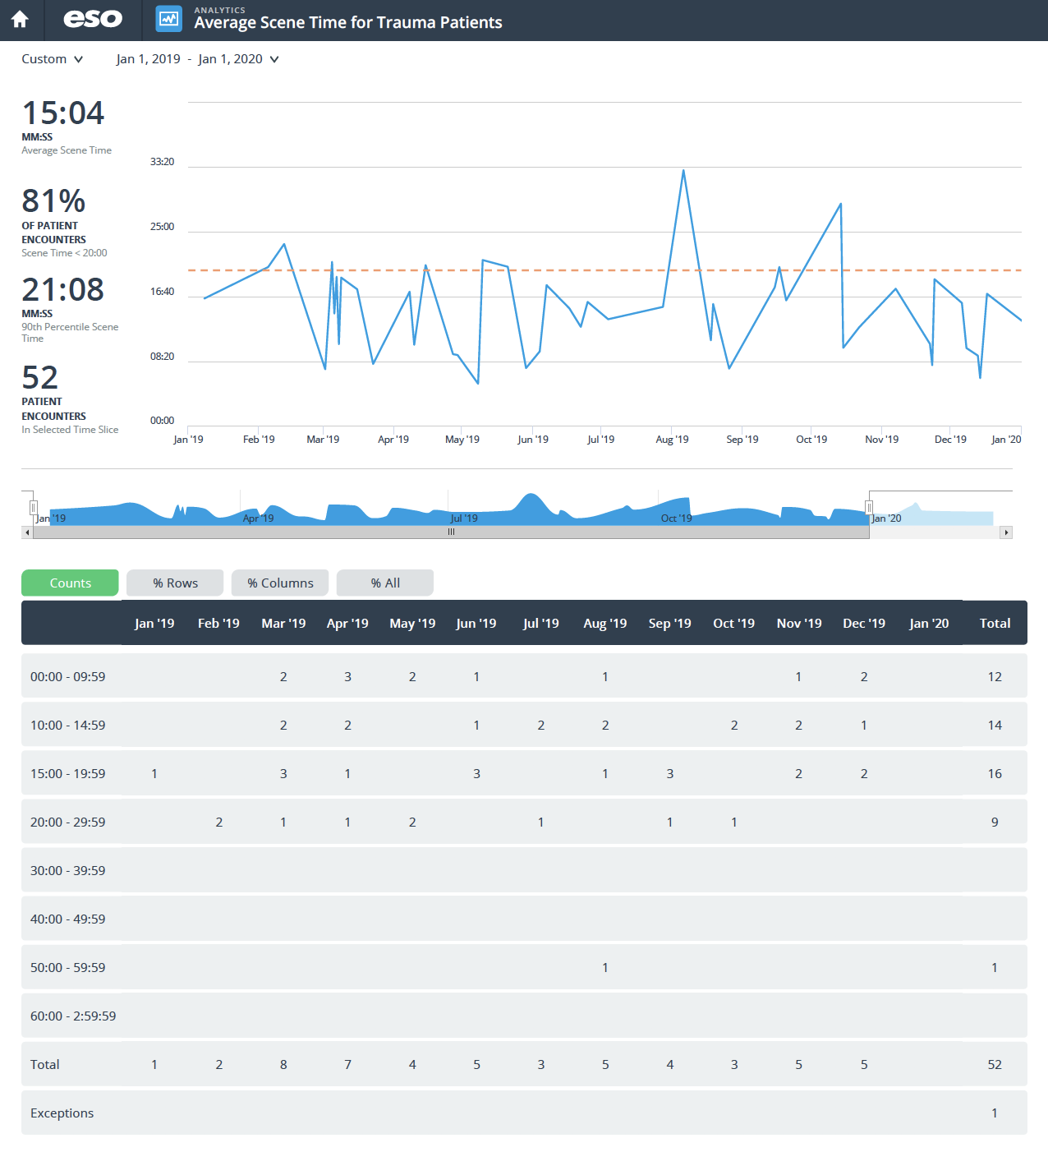
What about your department?
airway 2,000
What is this comparable to?
How do we change it for the better?
Examples
Type to enter a caption.
Notes:
last year

Slide 39
Homework? what?
Airway 2,000
https://prehospitalmed.com/category/airway/ x
https://emcrit.org/emcrit/emcrit-intubation-checklist/ x
https://emcrit.org/emcrit/toughness-michael-lauria-i/
https://emcrit.org/emcrit/situation-awareness-resuscitation-mike-lauria/
https://emcrit.org/emcrit/levitan-surgical-airway/ x
https://emcrit.org/emcrit/motr-commission-and-omission/
https://emcrit.org/emcrit/john-hinds-on-crack-the-chest-get-crucified/
https://www.foamfrat.com/index.php/foamfratpodcast/14-foamfrat-podcast/565-podcast-91-ketamine-analgesia,-rsi,-and-everything-in-between-w-michael-perlmutter x
https://www.uptodate.com/home
https://pubchem.ncbi.nlm.nih.gov

