Slide 1
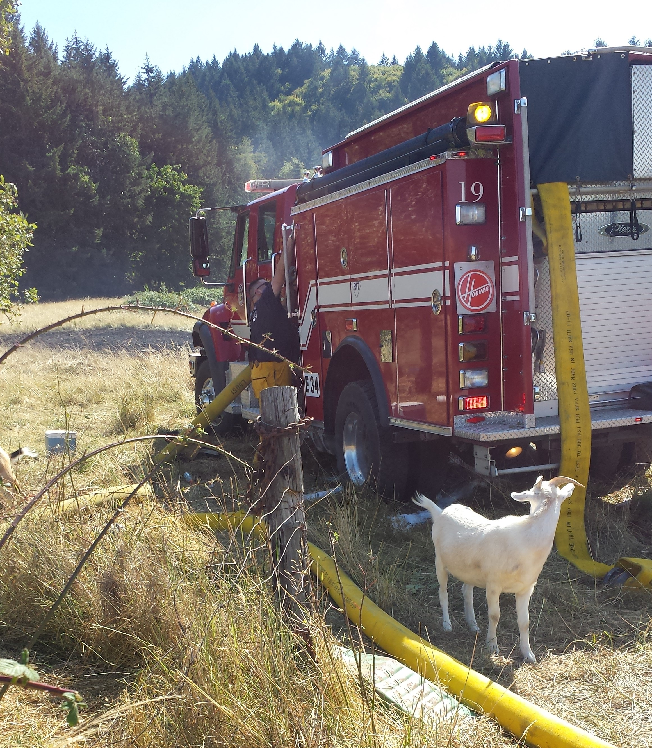

Rural Water Supply Operations
Tender Shuttles and Port-a-tank setup

Slide 2
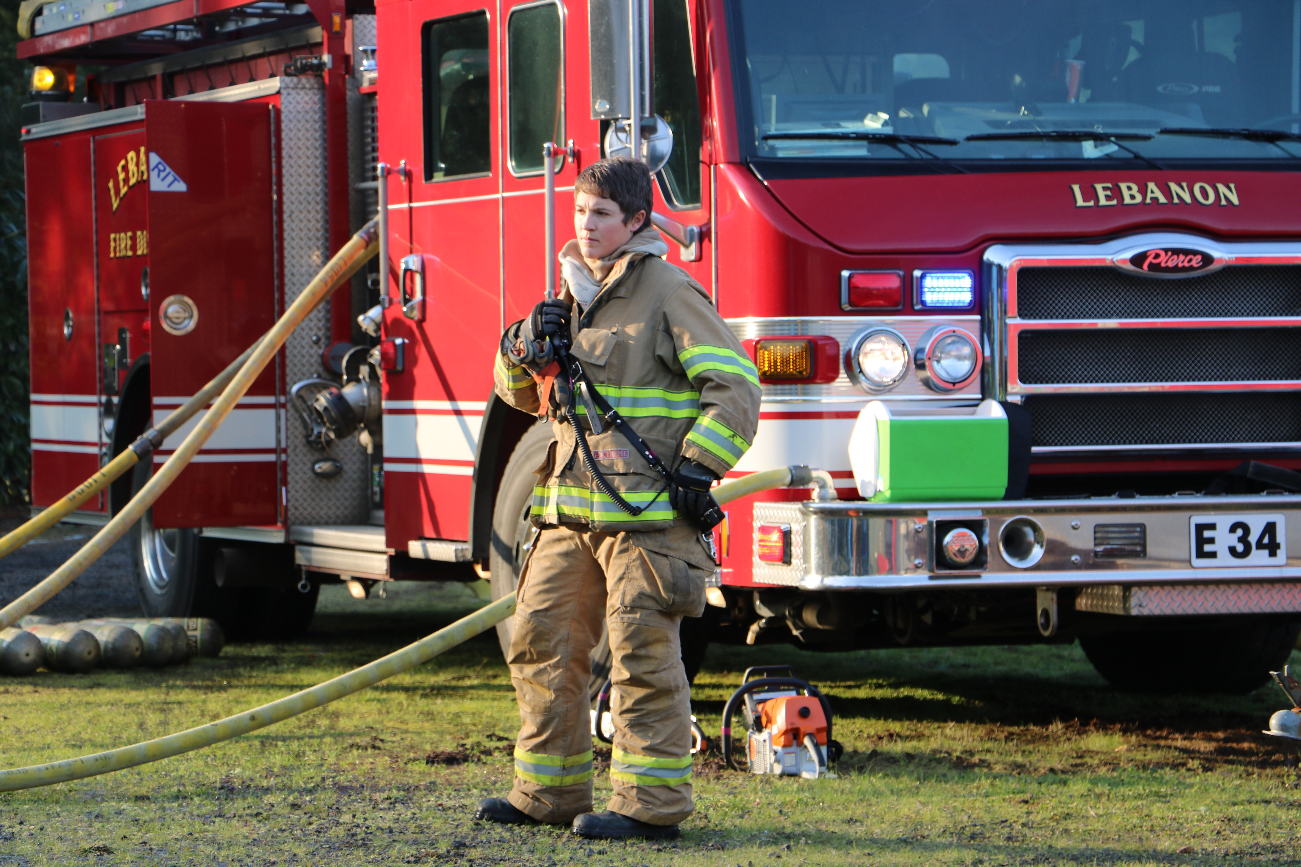
objectives
Defining the need
Determining flow requirements
Water supply officer
Tender shuttle operations
Port-a-tank operations

Slide 3
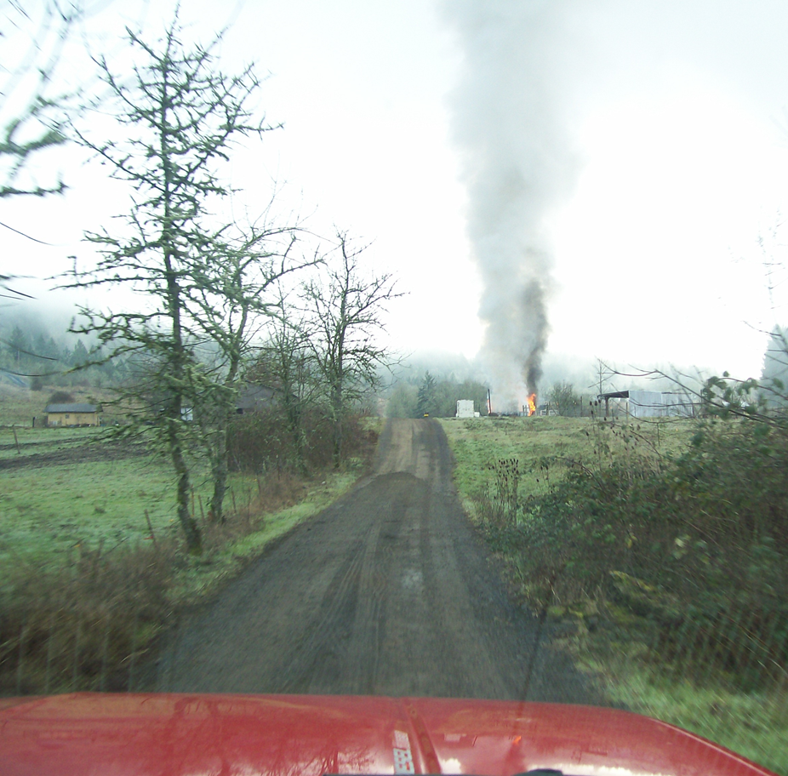
Rural water supply operations
Rural water supply operations are established when there is insufficient water to maintain the required water flow in an area where hydrants or adequate static water sources are not readily available.

Slide 4
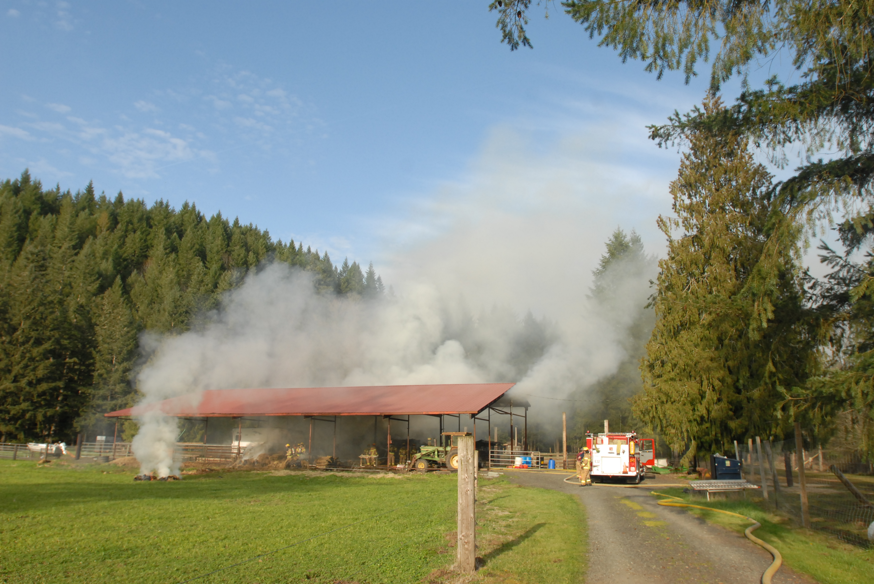
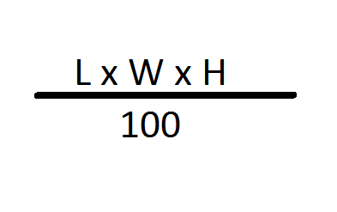

Determining Fire flow
Full-Involvement
Notes:
The Iowa Rate of Flow is based on work performed by Keith Royer and Bill Nelson while they were working for Iowa State University’s fire training program. While studying the effects of fog streams on interior fires, the pair demonstrated that all you need to do is put the right amount of water in the right place for the fire to go out—something that’s often overlooked by the modern fire service. This formula only gives you the formula for full involvement of the designated structure

Slide 5
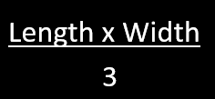
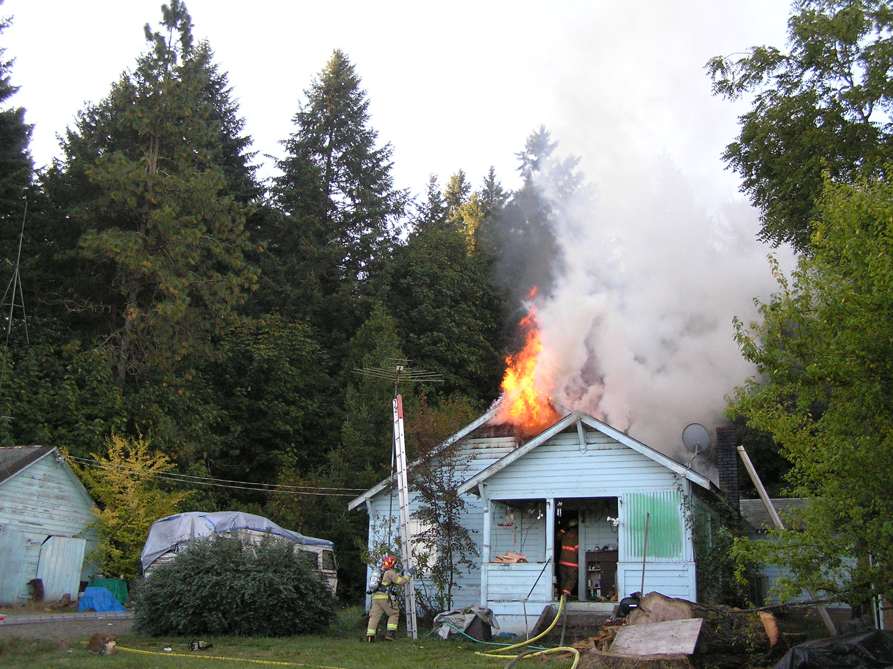
Determining Fire flow
x Percent involved
Example: A 30’ x 50’ building that’s 25 percent involved, the fire flow would be 30 x 50 = 1,500 square feet, divided by 3 = 500 x 0.25 = 125 gpm.
Notes:
The NFA formula was developed as part of the Preparing for Incident Command (PIC) Commanding the Initial Response (CIR) courses (late 1980s) based on experienced fire officers opinions about the flow rate required for attack lines and backup lines for hypothetical fire scenarios. The NFA formula was intended for offensive operations. The flow rates estimated by these officers was divided by the area of involvement for each scenario with the resulting constant being 3.

Slide 6
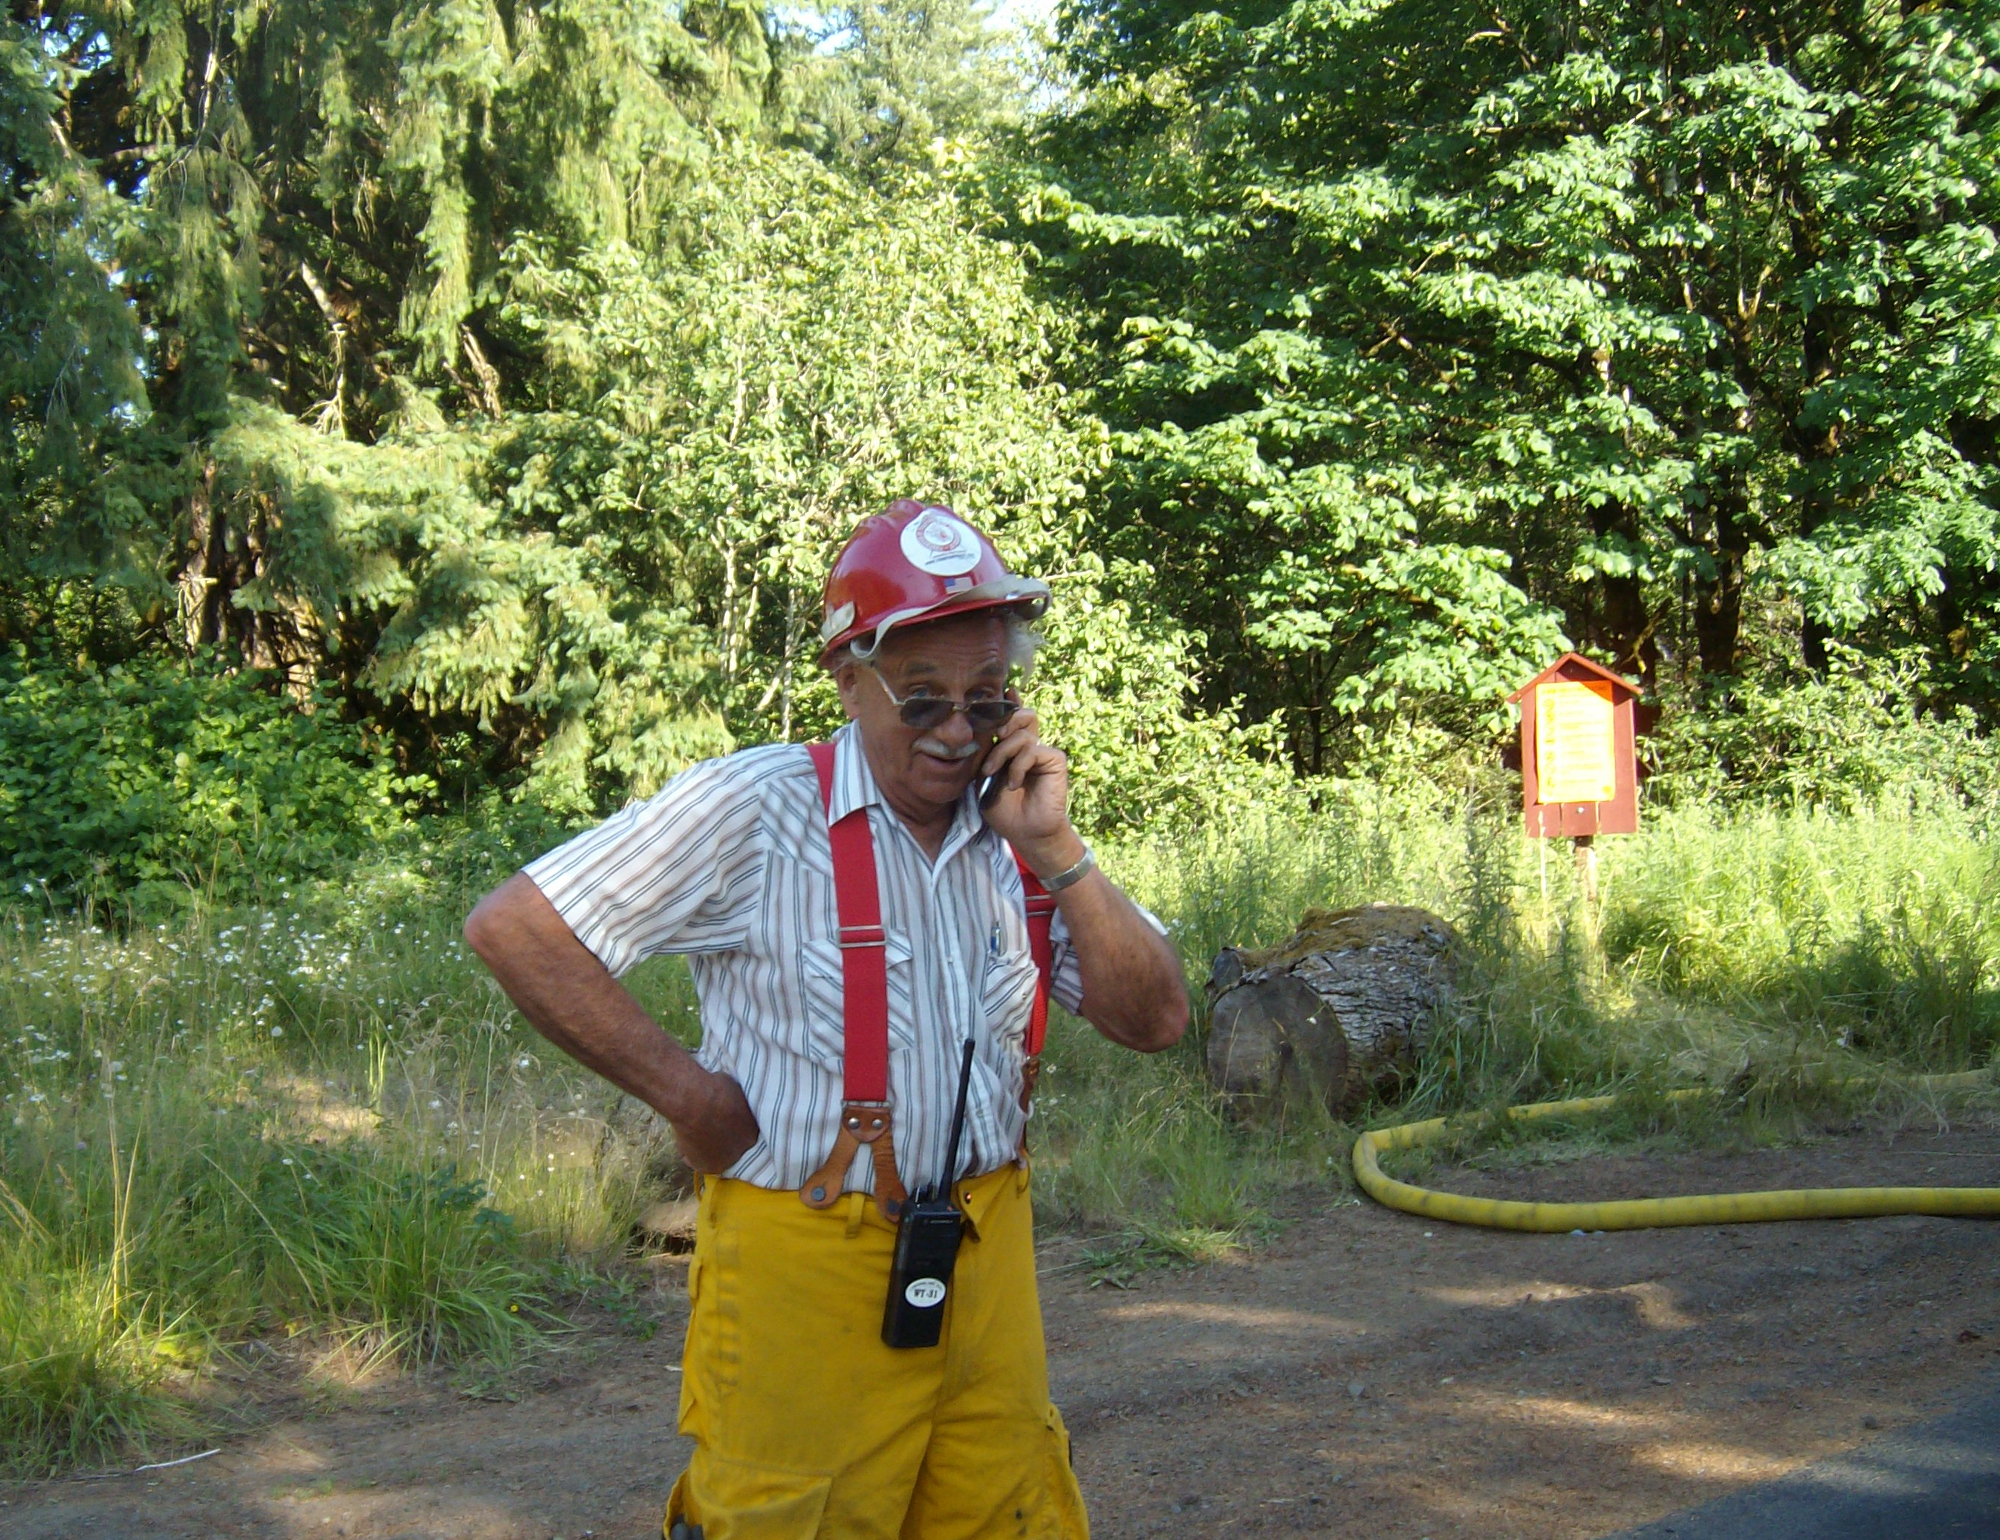
Water supply officer
The water supply officer
  Establish water supply needs (tender shuttle, port-a-tank operations)
  Determine fill site(s)
    Hydrants, rivers, static water sources
  Move radio traffic to F4
  Request additional water supply needs through

Slide 7
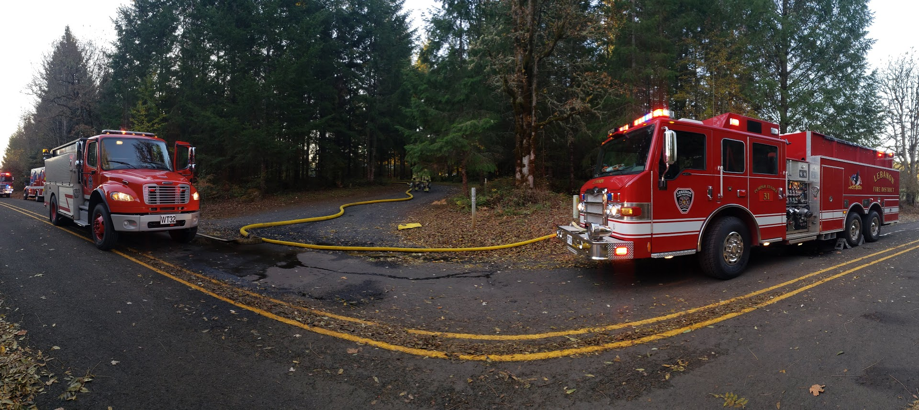
Tender Shuttle Operations

Slide 8
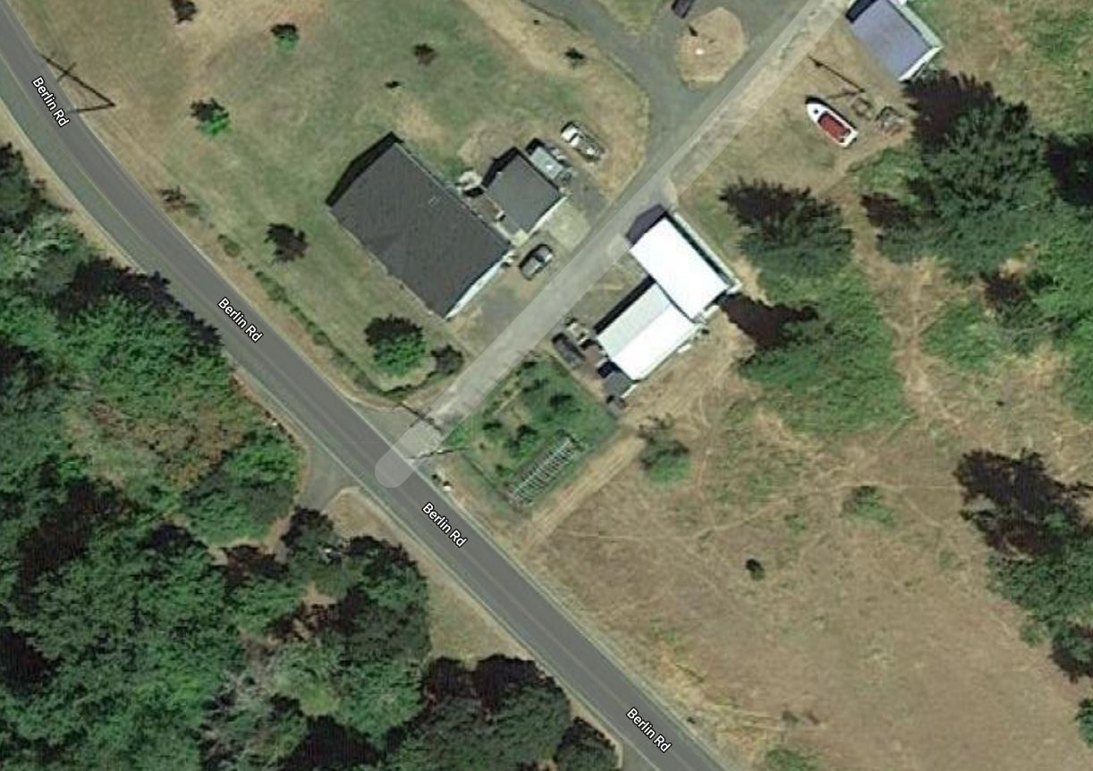


Tender shuttle operations
Manufactured
Home…

Slide 9
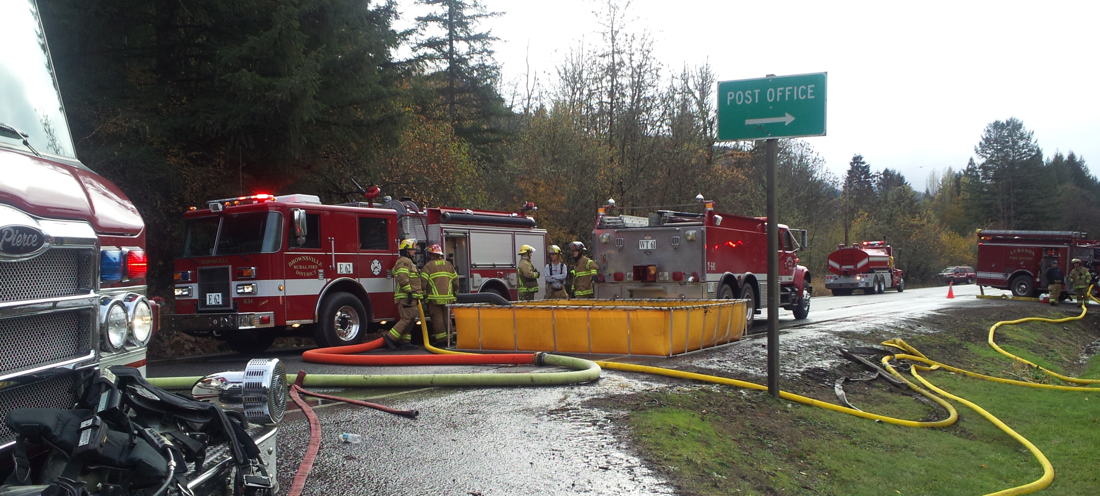
Port-a-tank operations

Slide 10



Single tank

Slide 11


Multiple tank

