Slide 1
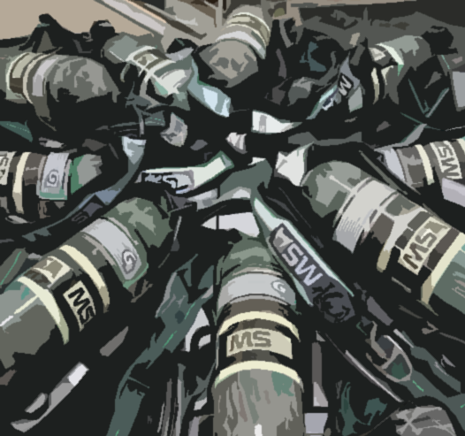
G1 MSA
SCBA

Slide 2
MSA G1 overview
Msa gi
  Cylinder 4500 PSI Bottle
  Frame
  Power System
  Pressure reducer
  Regulator/demand valve

Slide 3
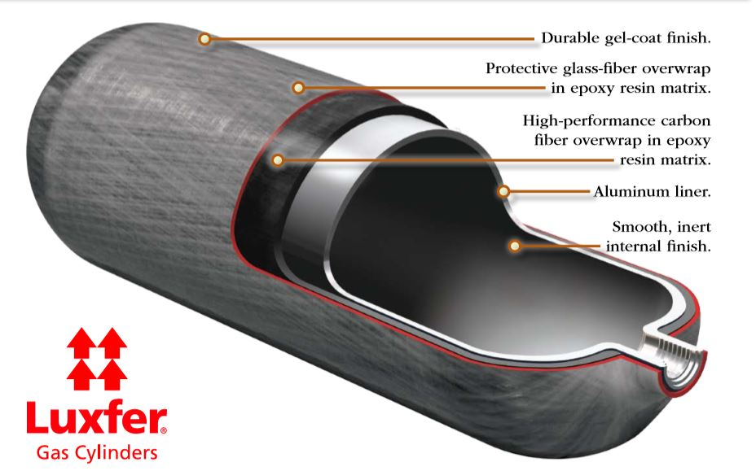
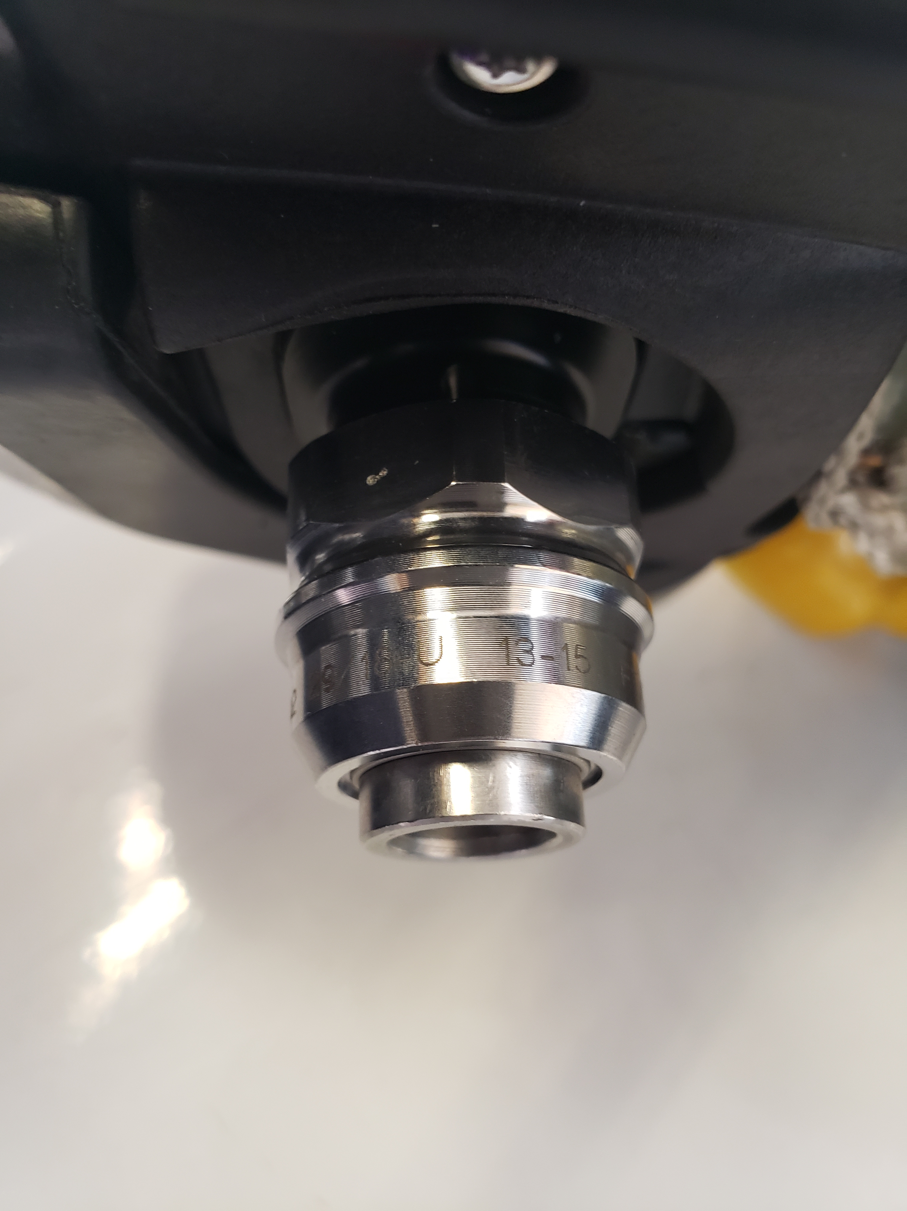
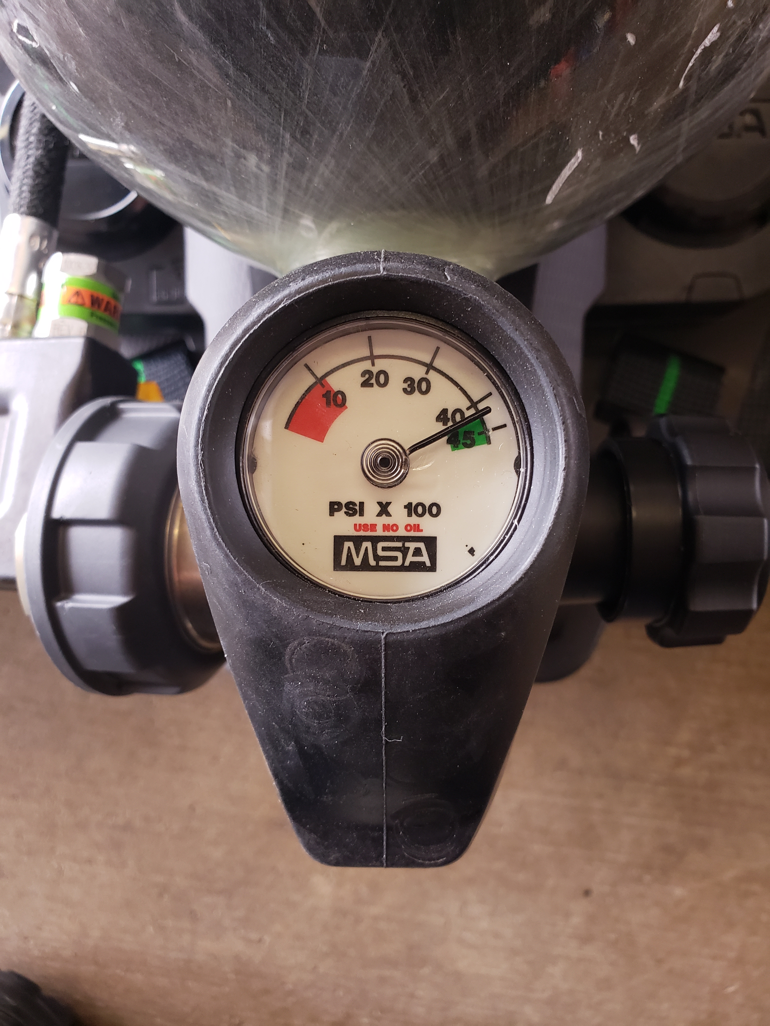
cylinder
Msa luxfer 4500 PSI /45 minute bottle
Seamless aluminum linear wrapped/wound in carbon fiber filaments and impregnated epoxy resin.
Hydrotest every 5 years

Slide 4
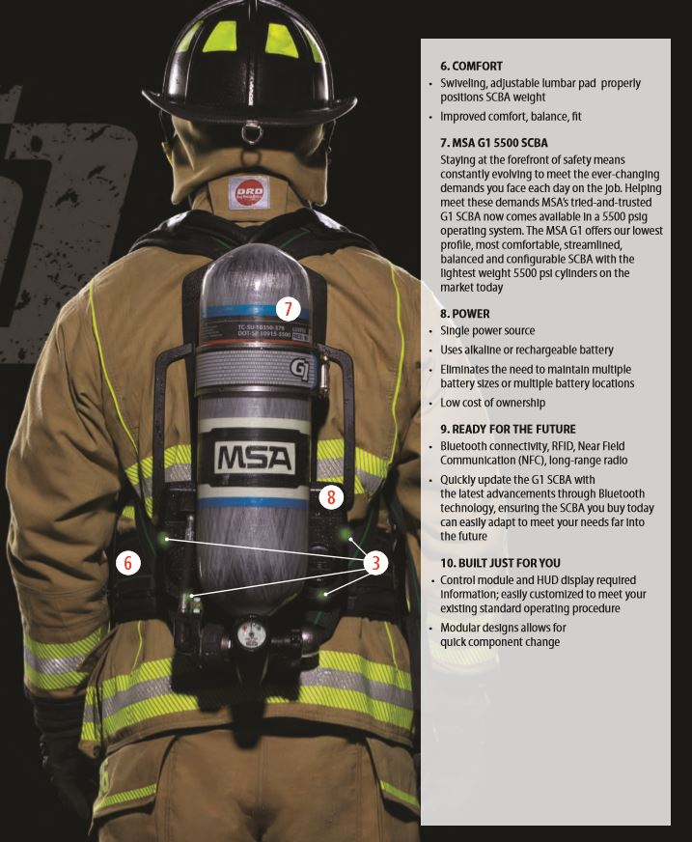
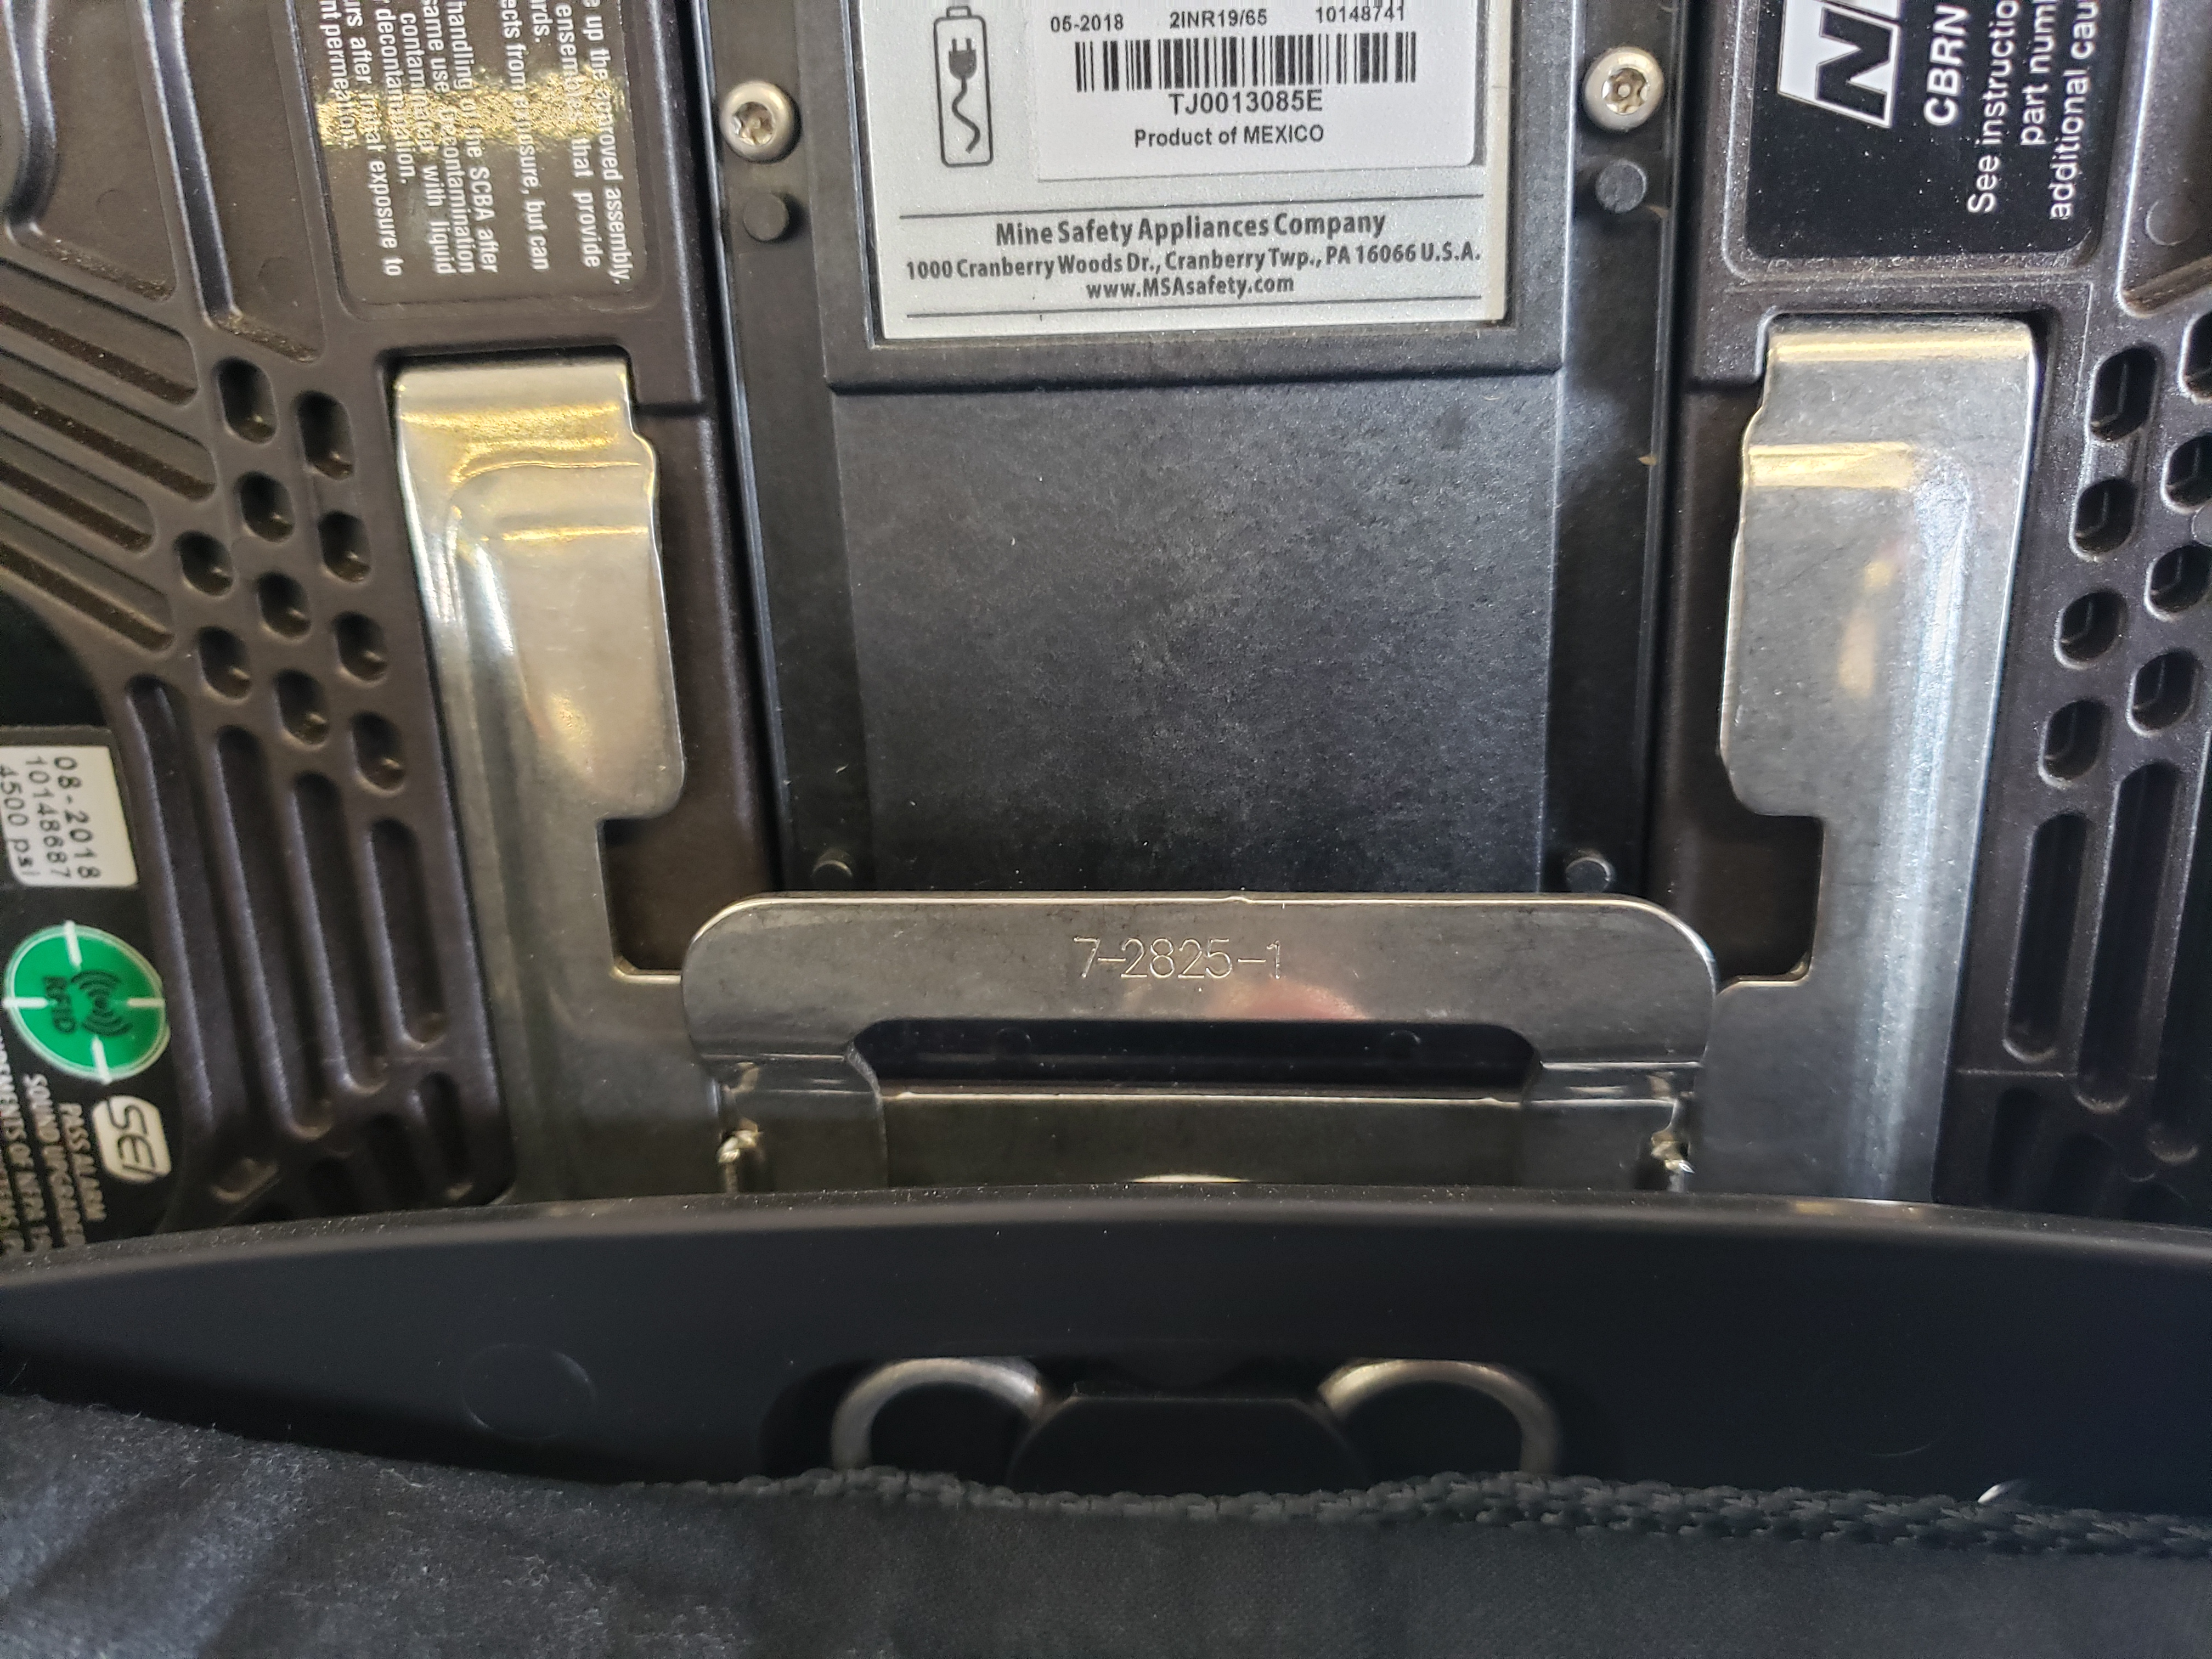
frame
Harness
  Backplate and Harness
  Adjustable Lumbar support 3 positions
  Shoulder Harness
  Waist Strap
Adjustable lumbar support

Slide 5
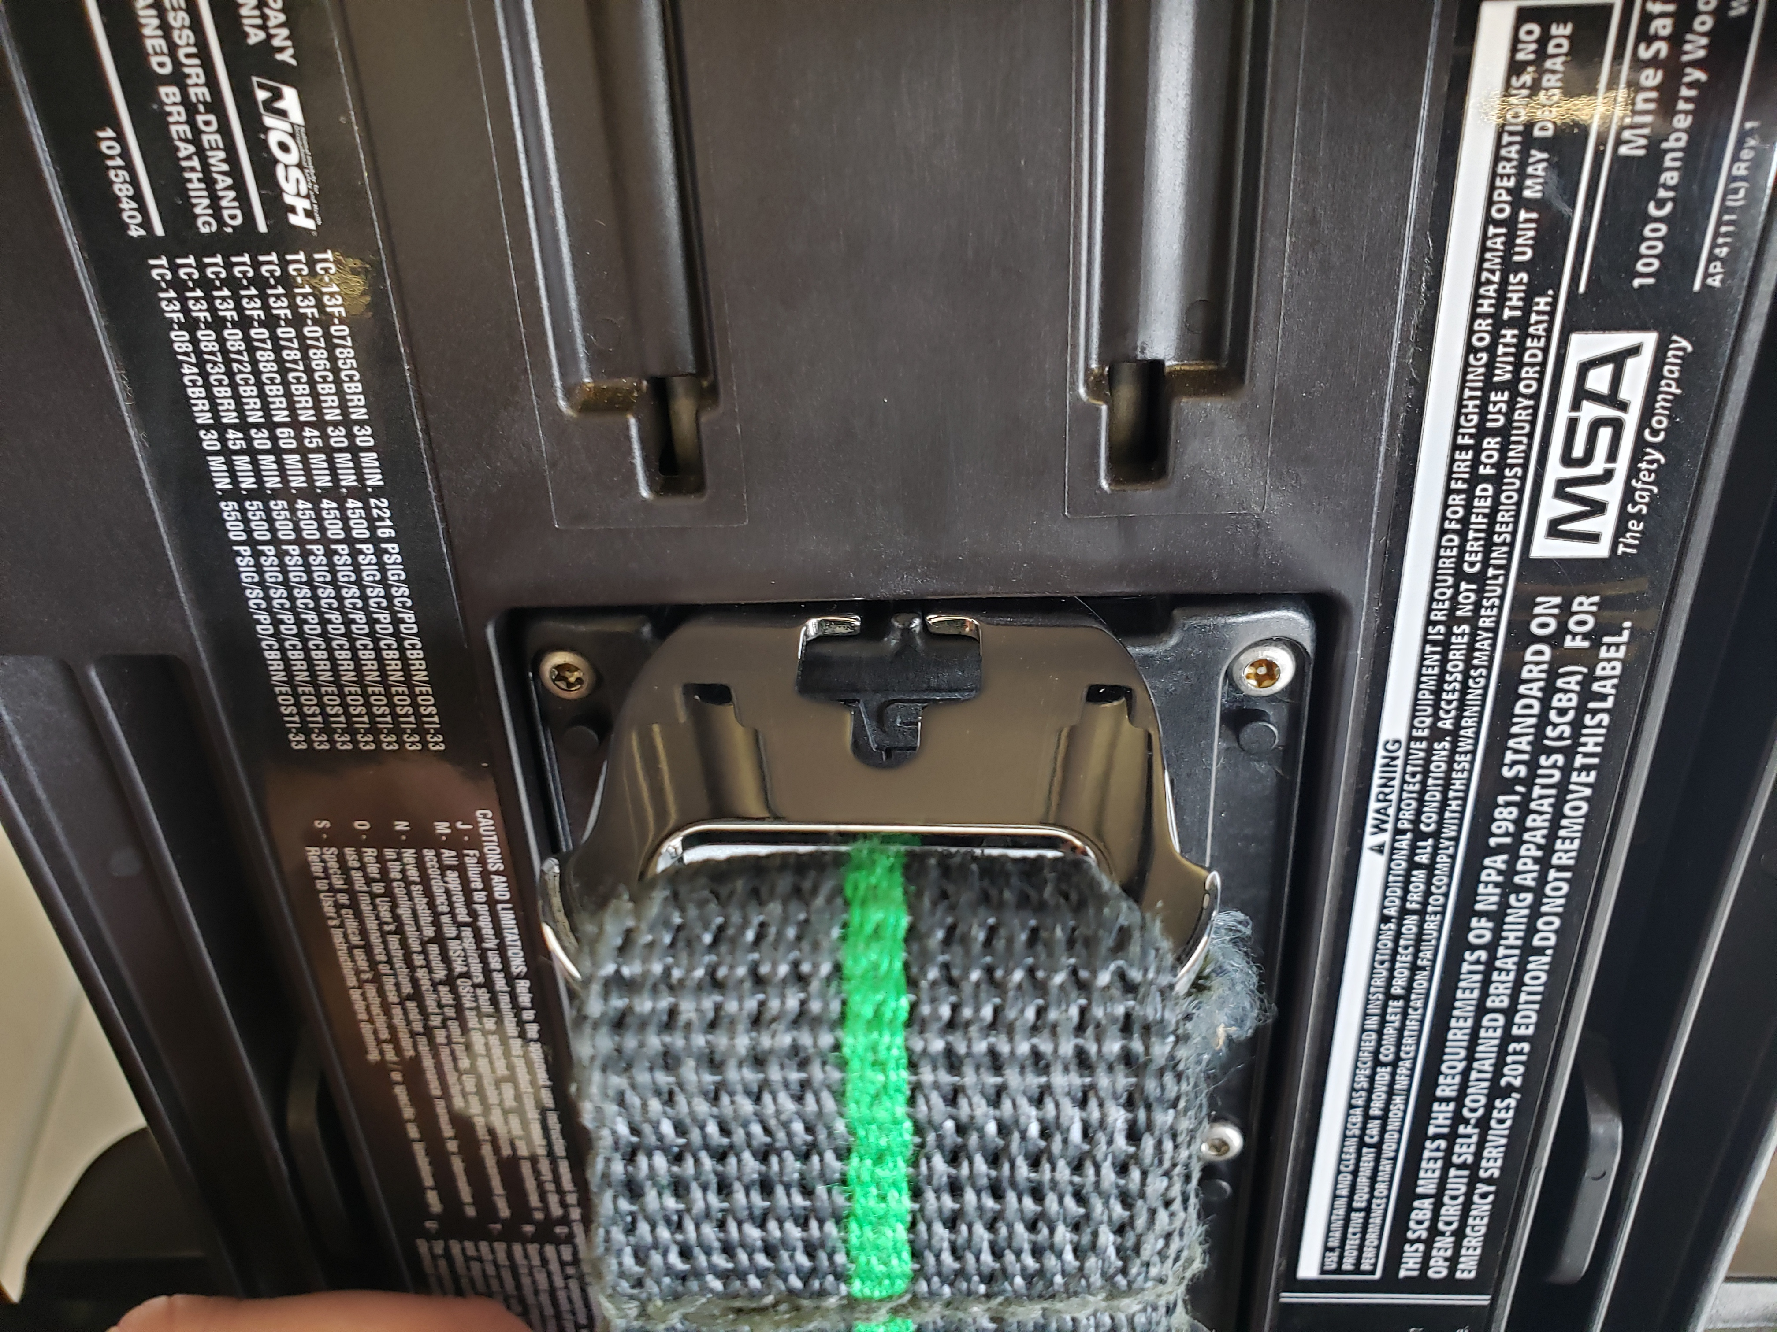
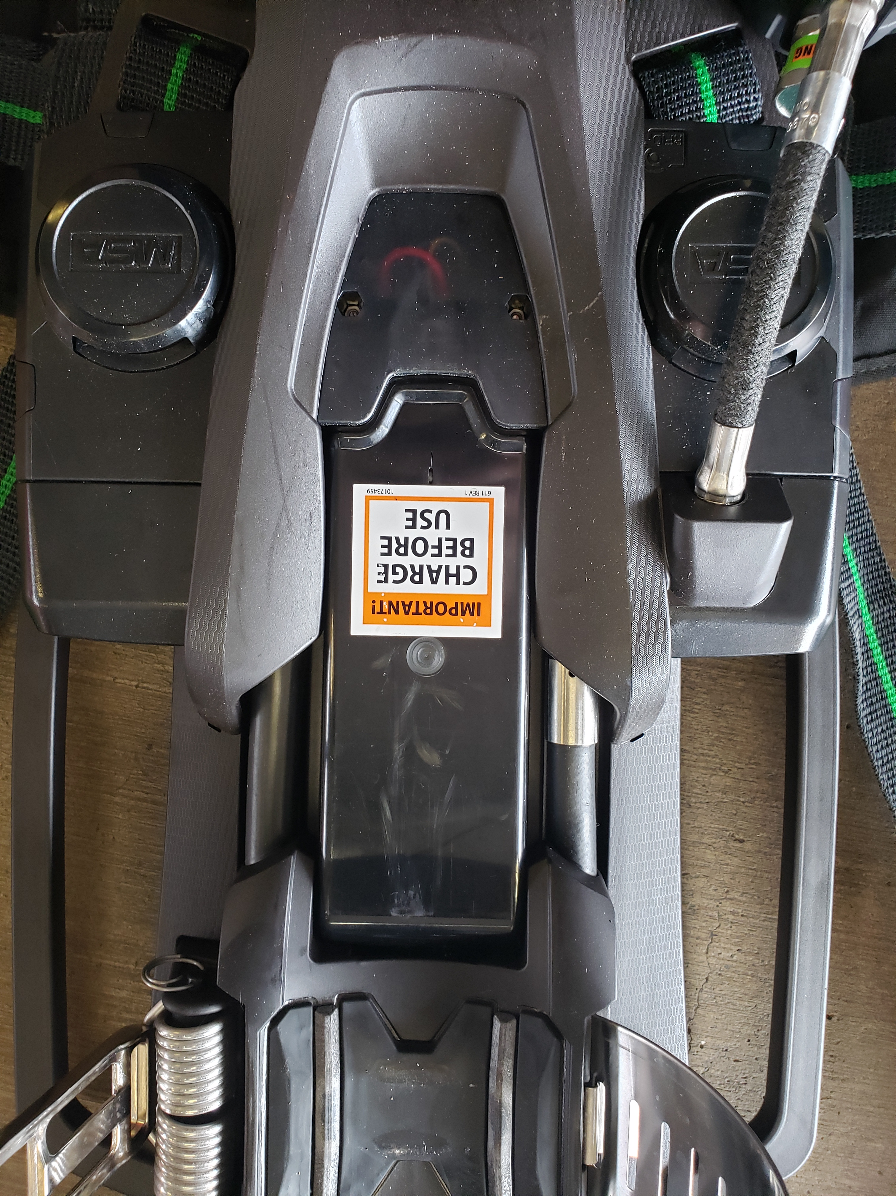
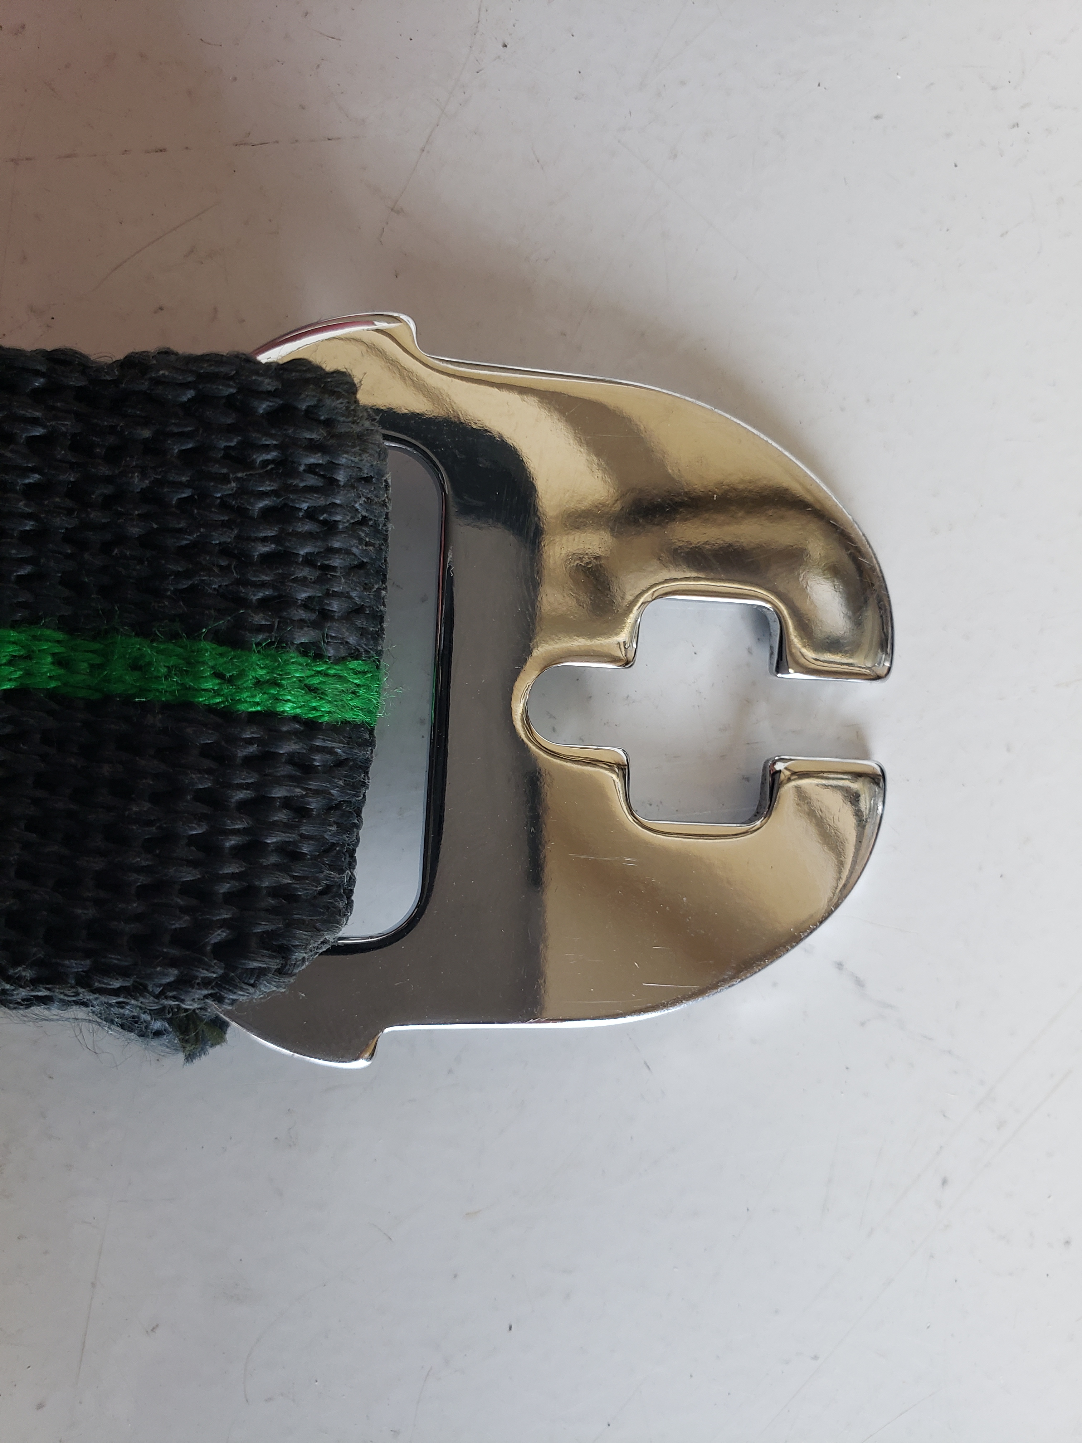
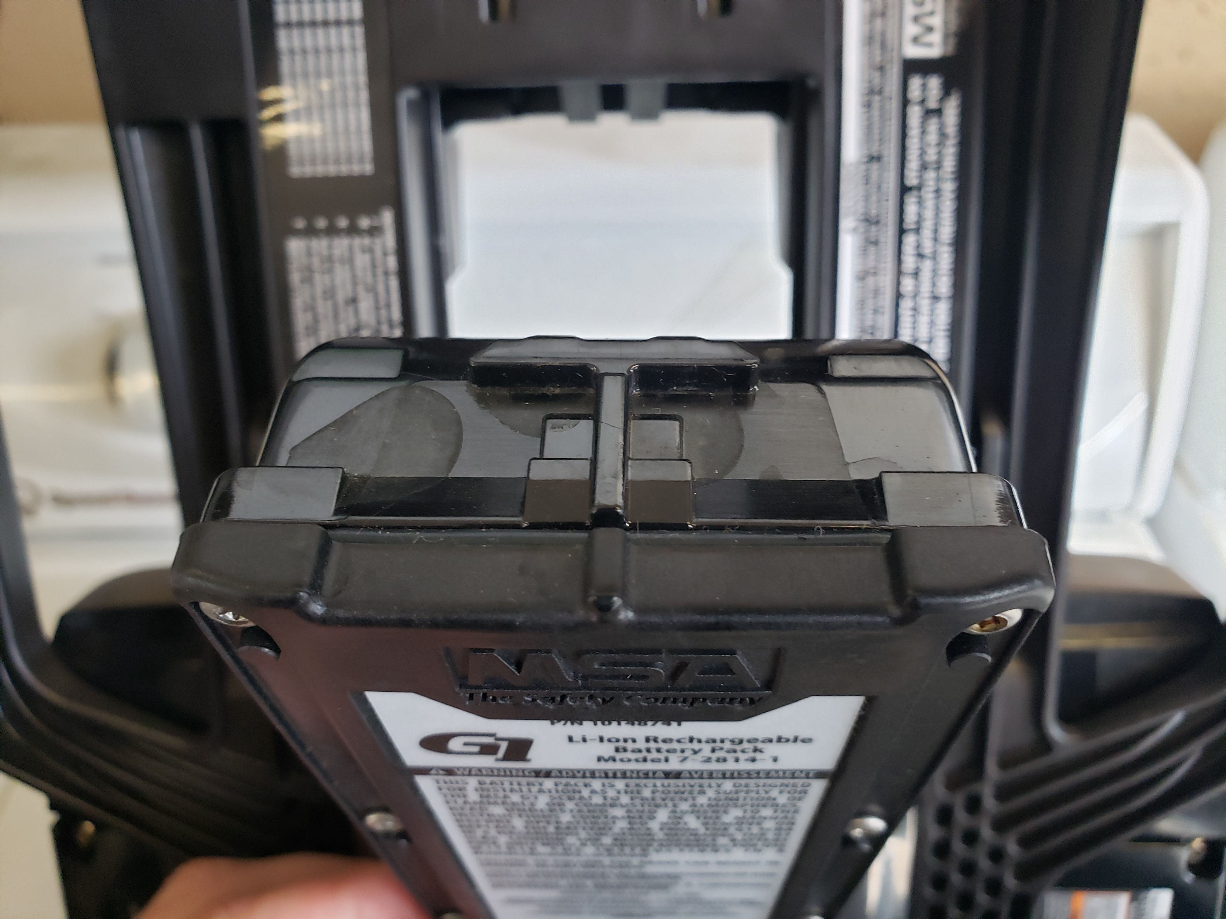
Frame - battery
Insert key for removal
Battery life -350-375 charge cycles
Fully charged battery lasts 10-12 hours
Control module will notify user if battery is low.
Control module beeps every 10 seconds if low.
Buckle key for battery removal

Slide 6
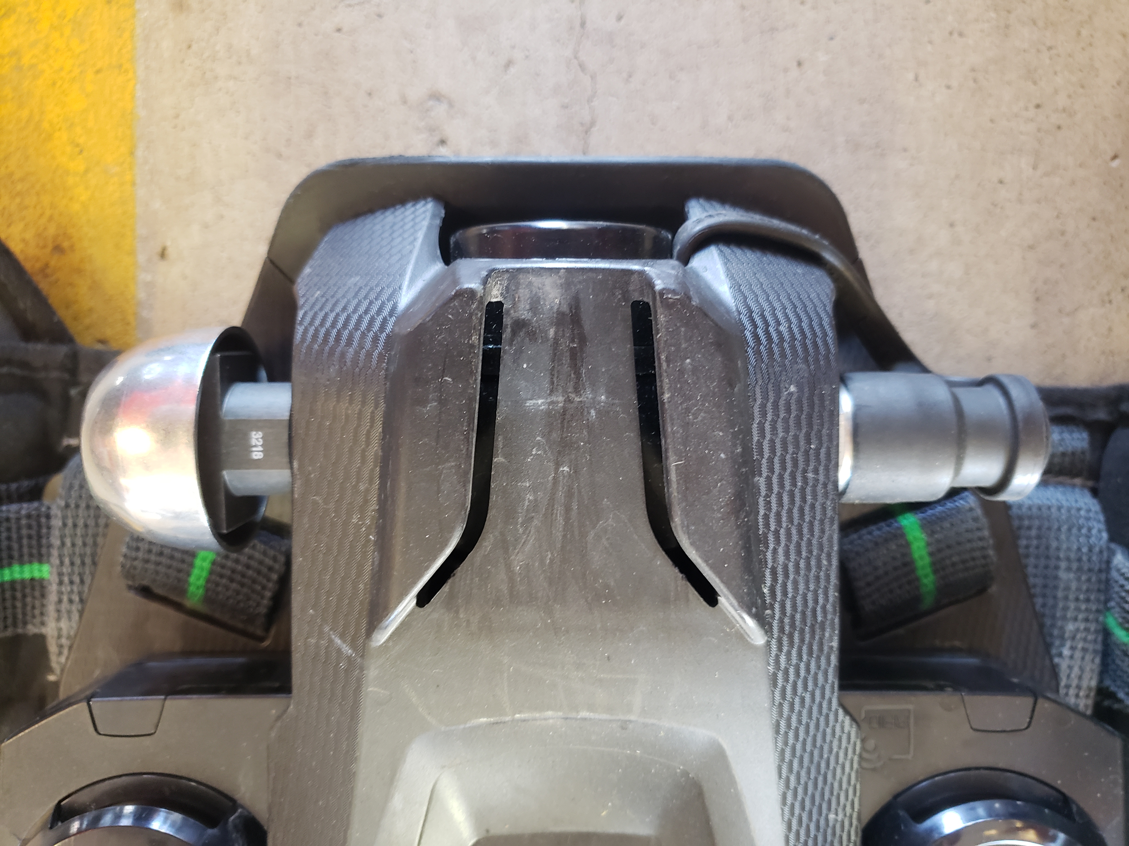
Primary low-pressure warning device (bell)
Alarms at 35% (+ or – 2%) of the bottle’s rated capacity.
  Approximately 1575 PSI

Slide 7
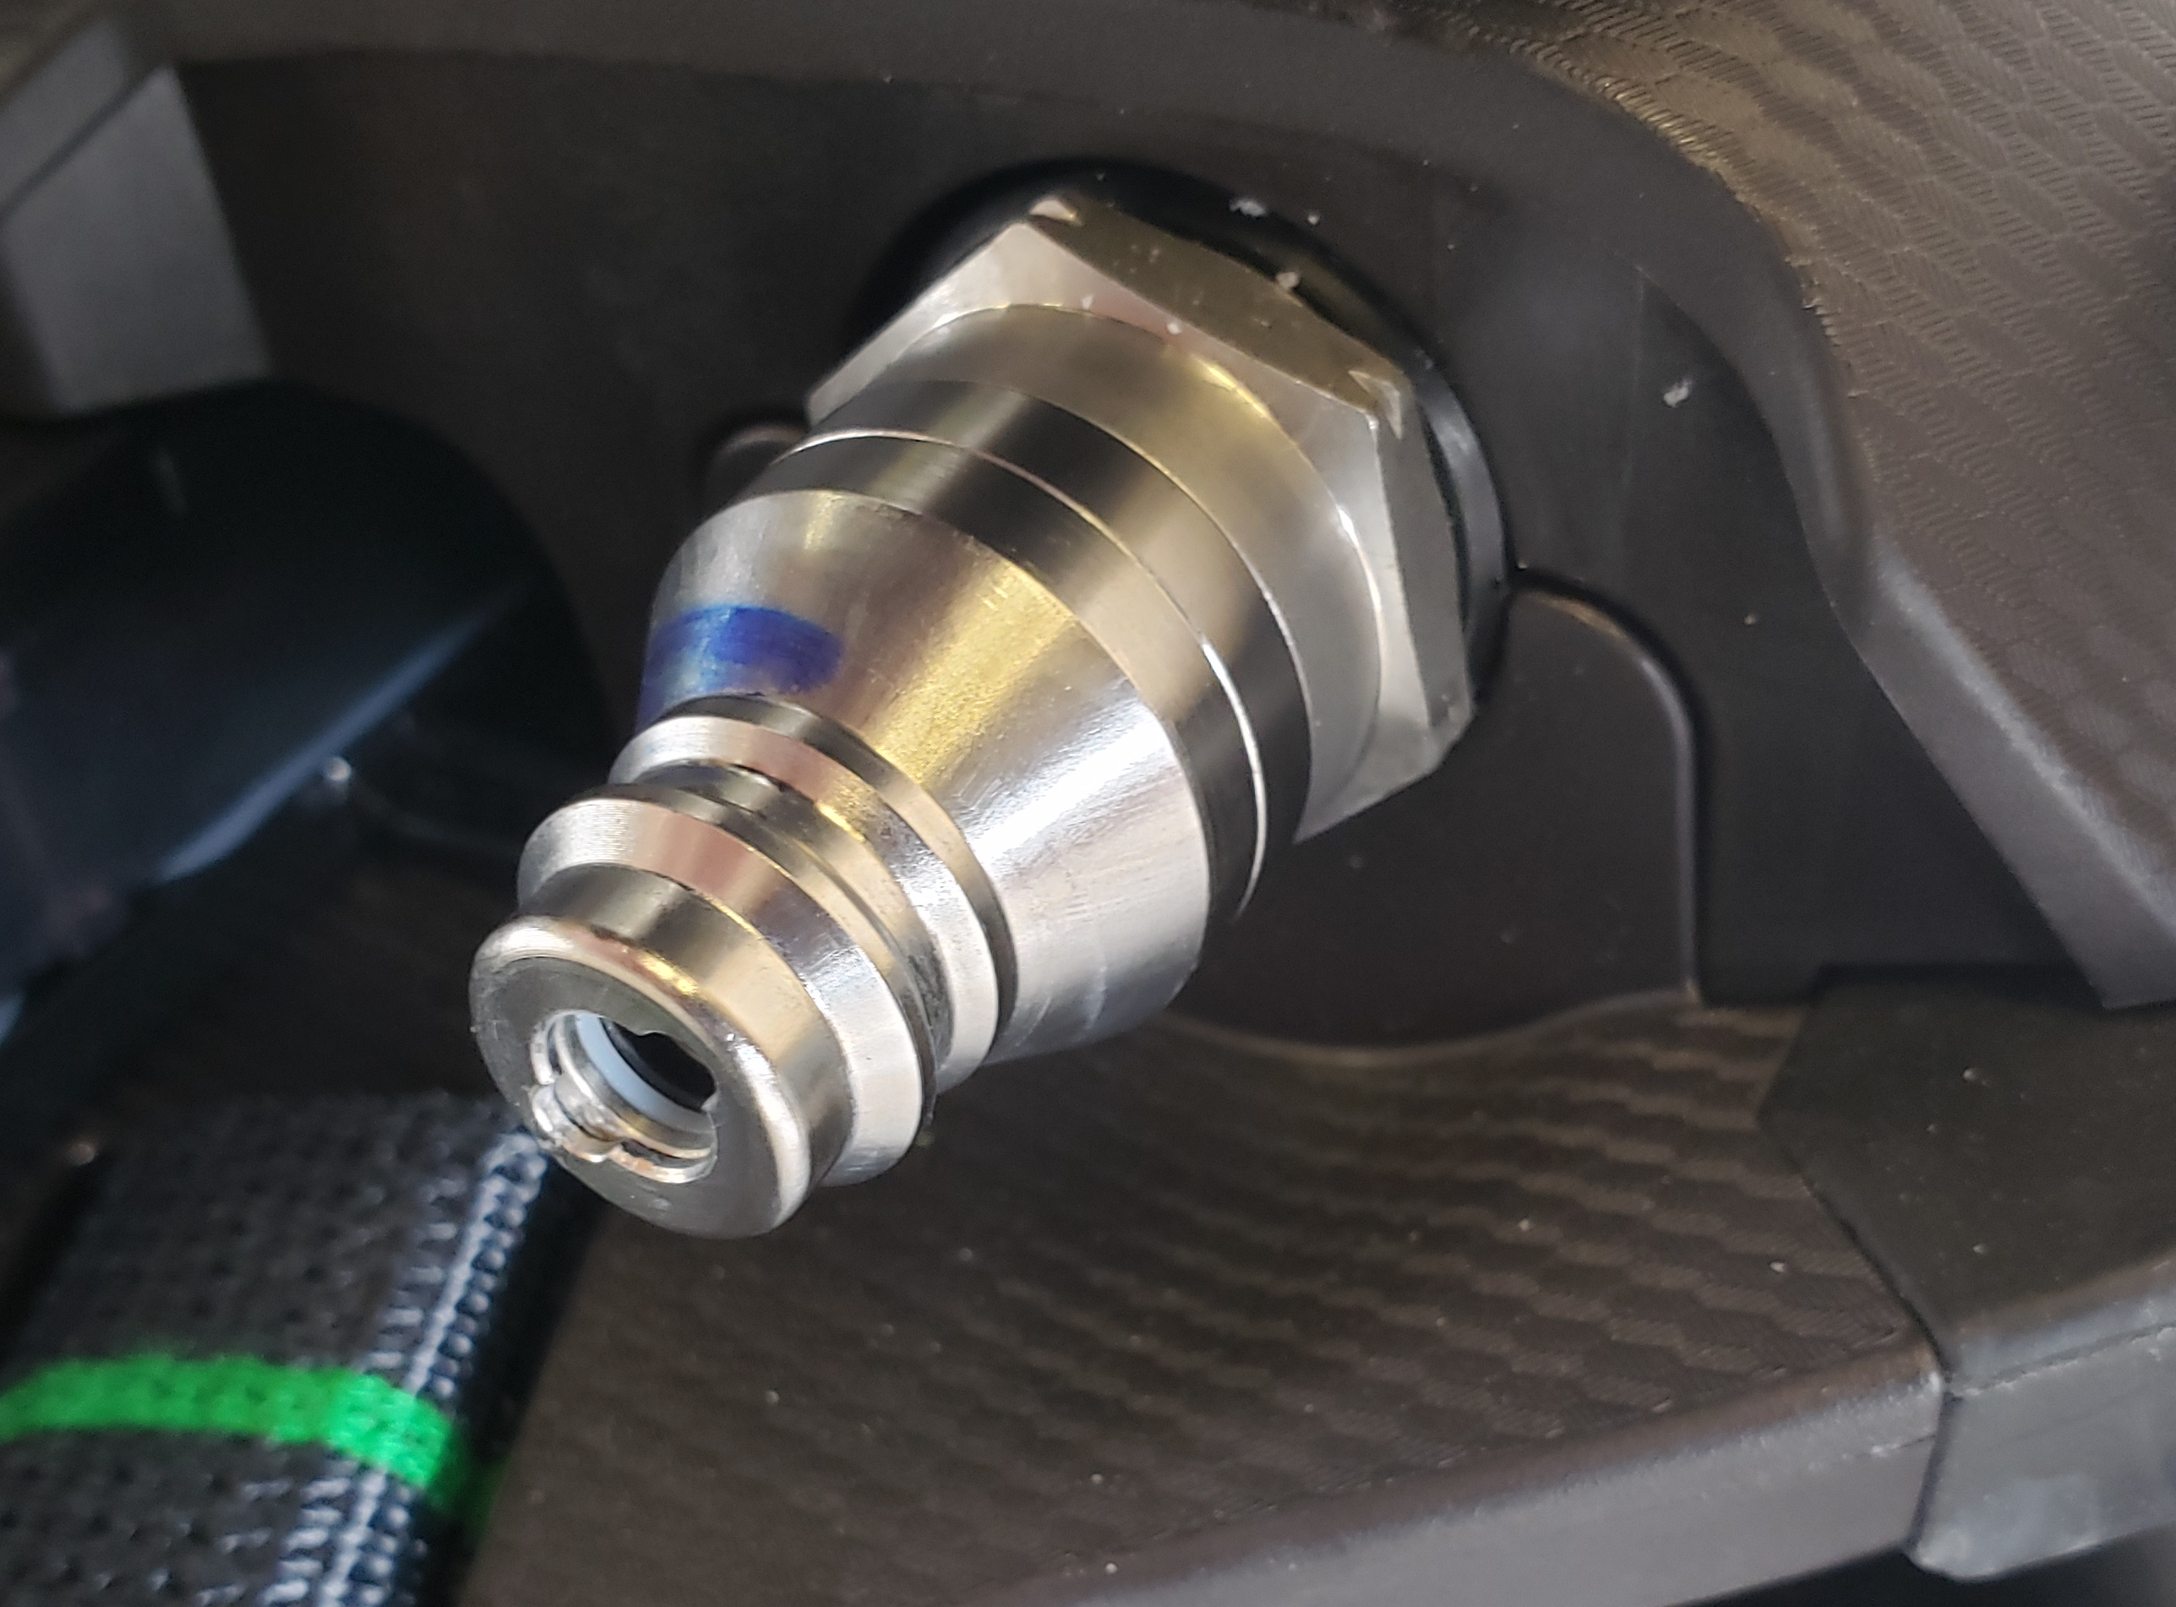
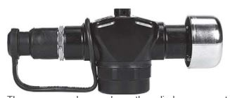
G1 Pressure reducer
Reduces cylinder pressure to an intermediate pressure. 110-115 psi.
Fitted with a rapid intervention (ric) Universal air connection (UAC)
  In 2002 nfpa required all manufacturers to include a uac

Slide 8
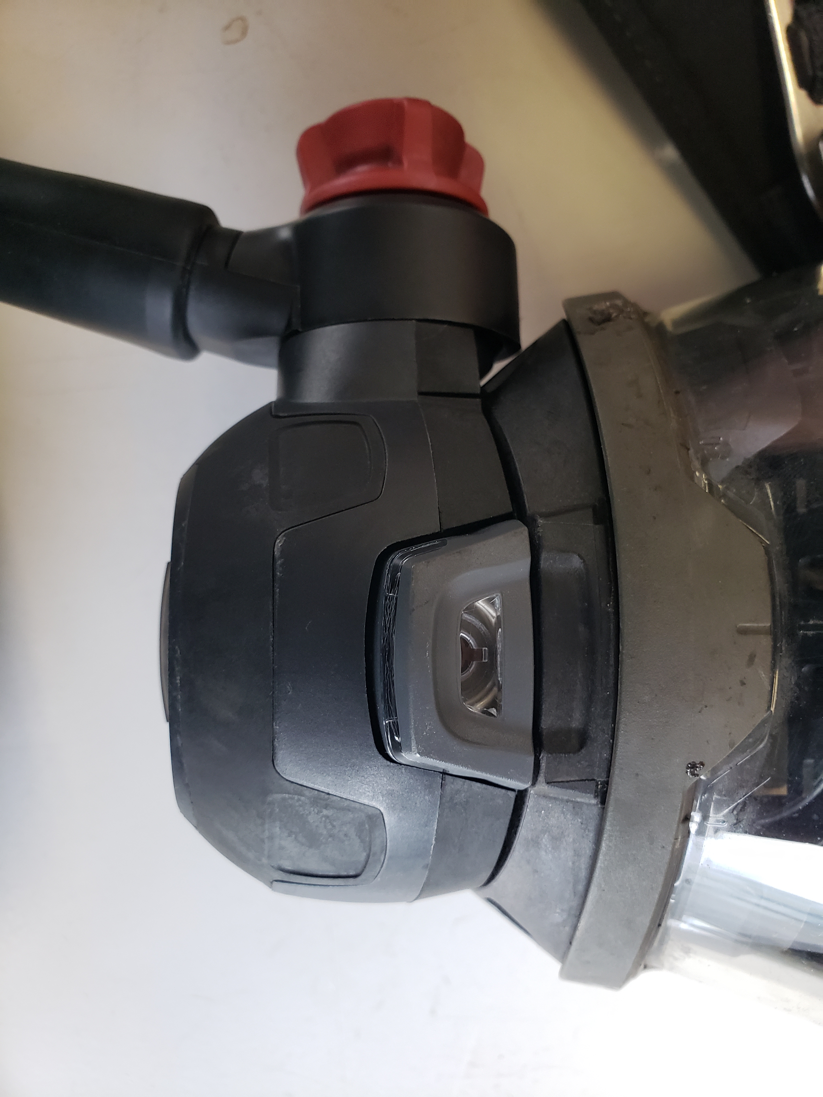
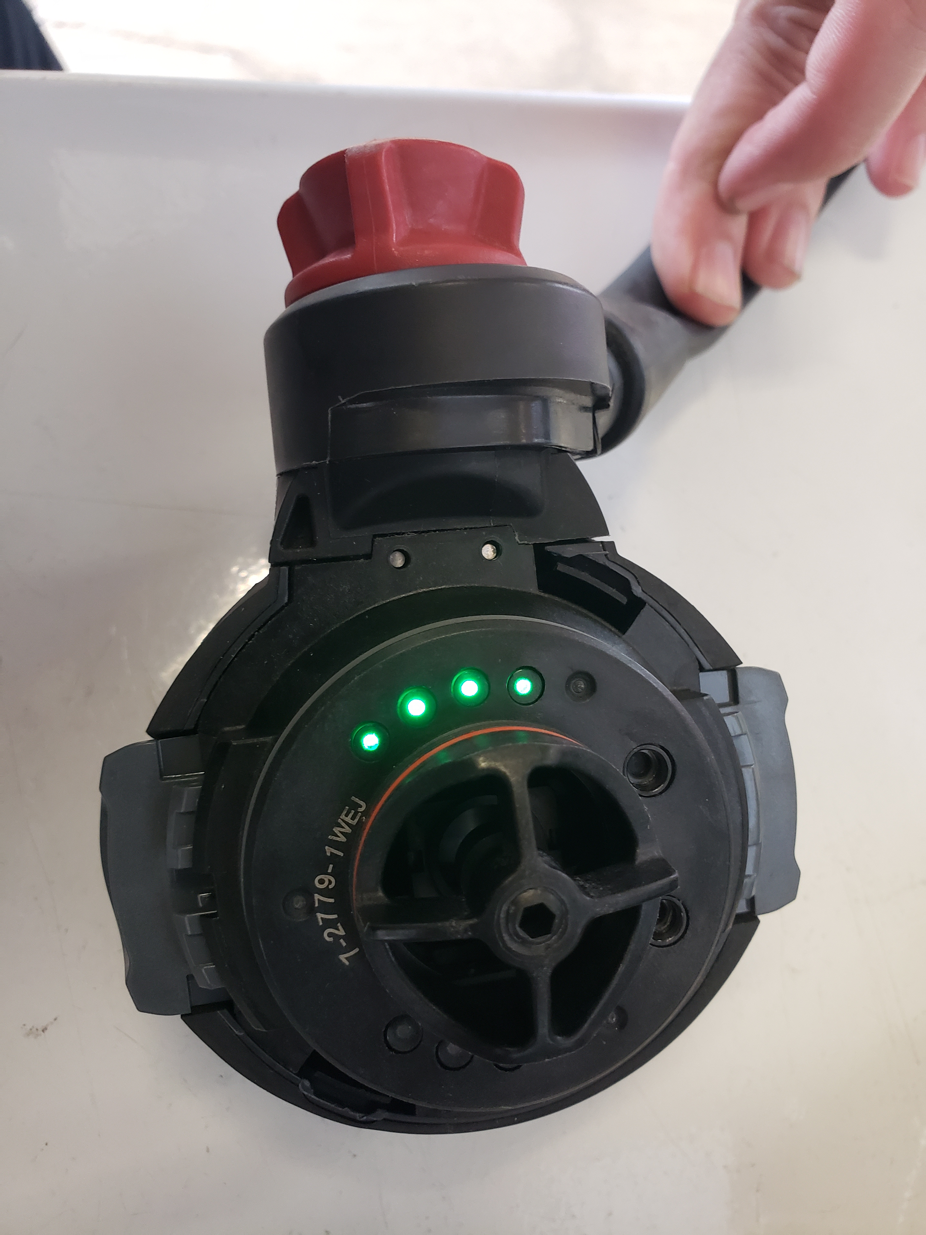
G1 Regulator or Demand Valve
Reduces pressure coming from the pressure reducer
  Pressure to 1.5mm of H20 (slightly above atmospheric pressure
  Approximately 3-15 PSI based on demand
Bypass Alarm location (Red Knob) Continuous flow
Houses an electric module which provides hud functionality and microphone placement

Slide 9
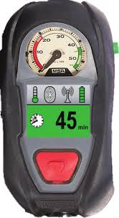
Control module
the interface with the scba and the personal alert safety system (Pass)
Analog gauge
Fed by a high-pressure hose
Control module components:
Lcd (liquid crystal display)
  Cylinder
  Battery status
  Time remaining active alarms

Slide 10
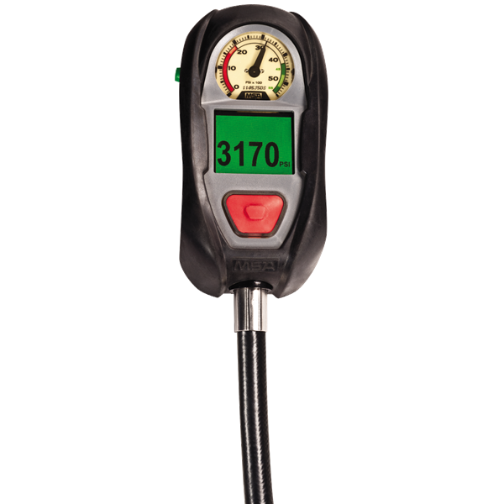
Control module
Alarm Button
Reset buttons
  Located on both sides of the control module. Resets
  the integrated PASS device and turns off the control
  once air pressure has been bled from the ICM.

Slide 11
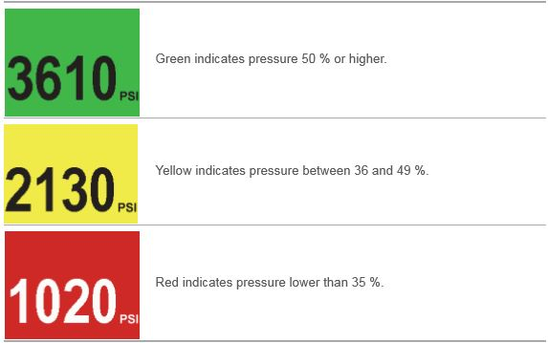
Control module
Scba pressure

Slide 12
Control module
Estimated time left
  Accomplished by pressing the side
  green reset buttons twice.
Low Battery alarm during normal operation
  Denoted by the battery symbol in the upper right side of the LCD
  Alarm beeps every 10 seconds
Battery Check
  Can be performed without the SCBA being turned on.
  Done by depressing one of the two reset buttons for 3 seconds.

